Slide 1
Single Layer Perceptron Classifier
By
Varun Deshmukh
Assistant Professor,
Department of Computer Engineering,
MPSTME, Shirpur Campus

Slide 2
CLASSIFICATION MODEL, FEATURES, AND
DECISION REGIONS
One of the most useful tasks that can be performed by networks of interconnected nonlinear elements introduced in the previous chapter is pattern classification.
A pattern is the quantitative description of an object, event, or phenomenon.
The classification may involve spatial and temporal patterns. Examples of spatial patterns are pictures, video images of ships, weather maps, fingerprints and characters.
Examples of temporal patterns include speech signals, signal vs time produced by sensors, electrocardiograms, and seismograms.
Temporal patterns usually involve ordered sequences of data appearing in time.
The goal of pattern classification is to assign a physical object, event, or phenomenon to one of the prespecified classes (also called categories.).
Despite the lack of any formal theory of pattern perception and classification, human beings and animals have performed these tasks since the beginning of their existence.

Slide 3
CLASSIFICATION MODEL, FEATURES, AND
DECISION REGIONS
The oldest classification tasks required from a human being have been classification of the human environment into such groups of objects as living species, plants, weather conditions, minerals, tools, human faces, voices etc.
The interpretation of data has been learned gradually as a result of repetitive inspecting and classifying of examples.
When a person perceives a pattern, an inductive inference is made and the perception is associated with some general concepts or clues derived from the person's past experience.
The problem of pattern classification may be regarded as one of discriminating the input data within object population via the search for invariant attributes among members of the population.

Slide 4
CLASSIFICATION MODEL, FEATURES, AND
DECISION REGIONS
While some of the tasks mentioned above can be learned easily, the growing complexity of the human environment and technological progress has created classification problems that are diversified and also difficult.
As a result, the use of various classifying aids became helpful and in some applications, even indispensable.
Reading and processing bank checks exemplifies a classification problem that can be automated.
It obviously can be performed by a human worker, however, machine classification can achieve much greater efficiency.
Extensive study of the classification process has led to the development of an abstract mathematical model that provides the theoretical basis for classifier design.
Eventually, machine classification came to maturity to help people in their classification tasks.

Slide 5
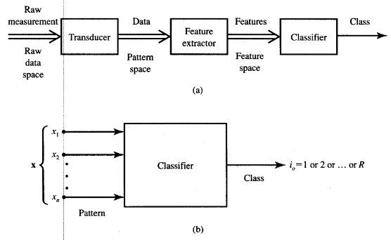
CLASSIFICATION MODEL, FEATURES, AND
DECISION REGIONS
The electrocardiogram waveform, biomedical photograph, or disease diagnosis problem can nowadays be handled by machine classifiers.
Other applications include fingerprint identification, patent searches, radar and signal detection, printed and written character classification, and speech recognition.
Figure shows the block diagram of the recognition and classification system.

Slide 6
CLASSIFICATION MODEL, FEATURES, AND
DECISION REGIONS
Recognition is understood here as a class assignment for input patterns that are not identical to the patterns used for training of the classifier.
Since the training concept has not been fully explained yet, we will focus first on techniques for classifying patterns.
The classifying system consists of an input transducer providing the input pattern data to the feature extractor.
Typically, inputs to the feature extractor are sets of data vectors that belong to a certain category.
Assume that each such set member consists of real numbers corresponding to measurement results for a given physical situation.
Usually, the converted data at the output of the transducer can be compressed while still maintaining the same level of machine performance.
The compressed data are called features. The feature extractor at the input of the classifier in Figure performs the reduction of dimensionality.

Slide 7
CLASSIFICATION MODEL, FEATURES, AND
DECISION REGIONS
The feature space dimensionality is postulated to be much smaller than the dimensionality of the pattern space.
The feature vectors retain the minimum number of data dimensions while maintaining the probability of correct classification, thus making handling data easier.
An example of possible feature extraction is available in the analysis of speech vowel sounds. A 16-channel filter-bank can provide a set of 16-component spectral vectors. The vowel spectral content can be transformed into perceptual quality space consisting of two dimensions only. They are related to tongue height and retraction.
Another example of dimensionality reduction is the projection of planar data on a single line, reducing the feature vector size to a single dimension. Although the projection of data will often produce a useless mixture, by moving and/or rotating the line it might be possible to find its orientation for which the projected data are well separated.

Slide 8
CLASSIFICATION MODEL, FEATURES, AND
DECISION REGIONS
In such a case, two-dimensional data are represented by single-dimensional features denoting the position of the projected points on the line.
It is beyond the scope of this chapter to discuss the selection of measurements or data feature extraction from the input pattern vector.
We shall henceforth assume that the sets of extracted feature vectors yield the sets of pattern vectors to be classified that the extraction, or selection, of input components to the classifier has been done as wisely as possible.
Thus, the pattern vector x shown in figure consists of components that may be features.
However the n-tuple vectors at the input to the classifier on Figure (b) may also be input pattern data when separate feature extraction does not take place.
In such a case the classifier's function is to perform not only the classification itself but also to internally extract input pattern features.

Slide 9
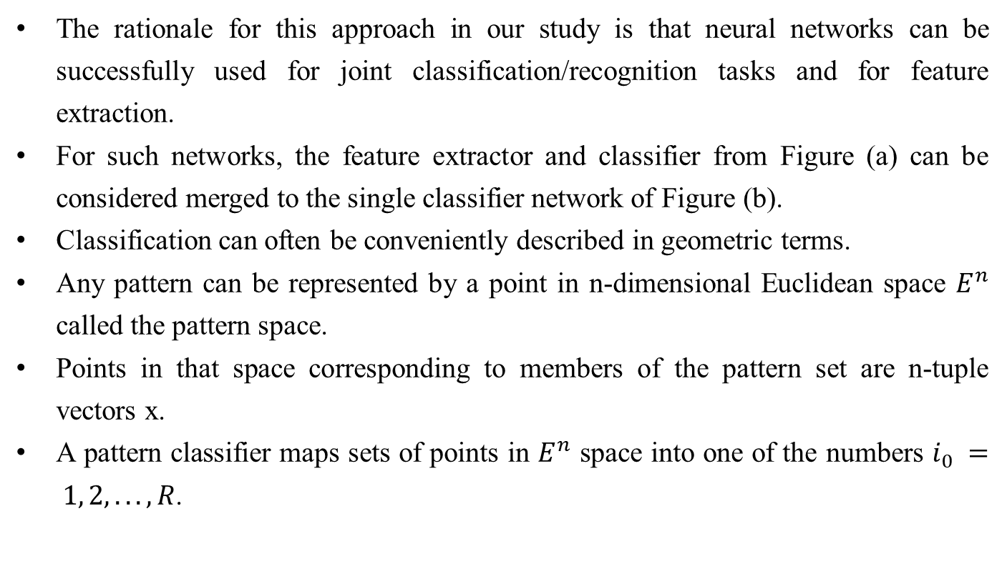
CLASSIFICATION MODEL, FEATURES, AND
DECISION REGIONS
The rationale for this approach in our study is that neural networks can be successfully used for joint classification/recognition tasks and for feature extraction.
For such networks, the feature extractor and classifier from Figure (a) can be considered merged to the single classifier network of Figure (b).
Classification can often be conveniently described in geometric terms.
Any pattern can be represented by a point in n-dimensional Euclidean space $E^{n}$ called the pattern space.
Points in that space corresponding to members of the pattern set are n-tuple vectors x.
A pattern classifier maps sets of points in $E^{n}$ space into one of the numbers $i_{0} = 1, 2, . . . , R$.

Slide 10
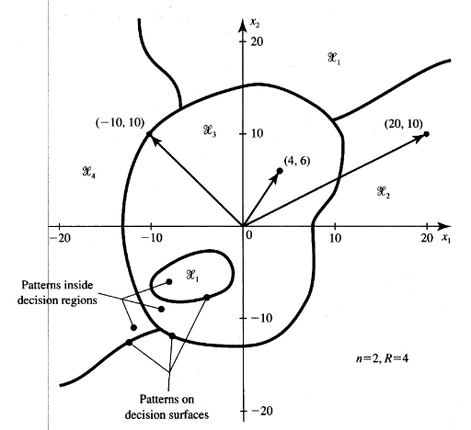
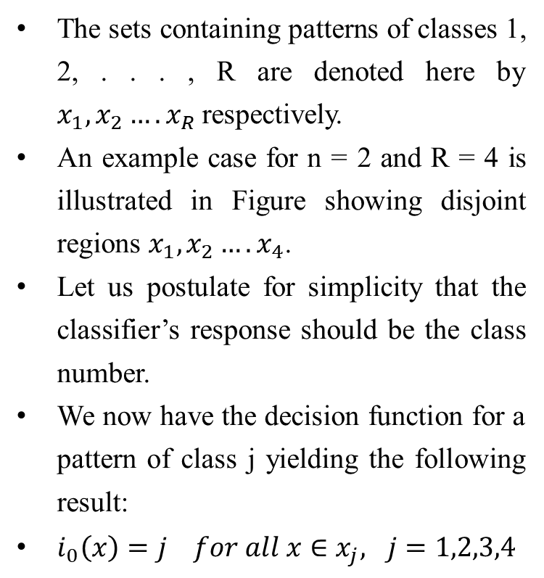
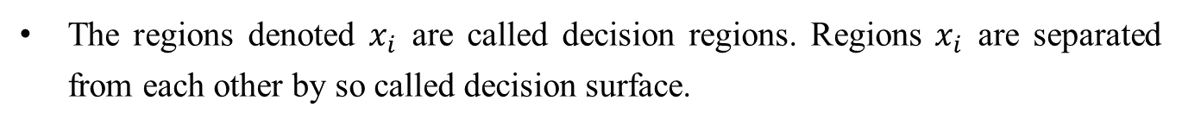
CLASSIFICATION MODEL, FEATURES, AND
DECISION REGIONS
The sets containing patterns of classes 1, 2, . . . , R are denoted here by $x_{1},x_{2}….x_{R}$respectively.
An example case for n = 2 and R = 4 is illustrated in Figure showing disjoint regions $x_{1},x_{2}….x_{4}$.
Let us postulate for simplicity that the classifier’s response should be the class number.
We now have the decision function for a pattern of class j yielding the following result:
$i_{0}\left(x\right)=j for all x∈x_{j}, j=1,2,3,4$
The regions denoted $x_{i}$ are called decision regions. Regions $x_{i}$ are separated from each other by so called decision surface.

Slide 11
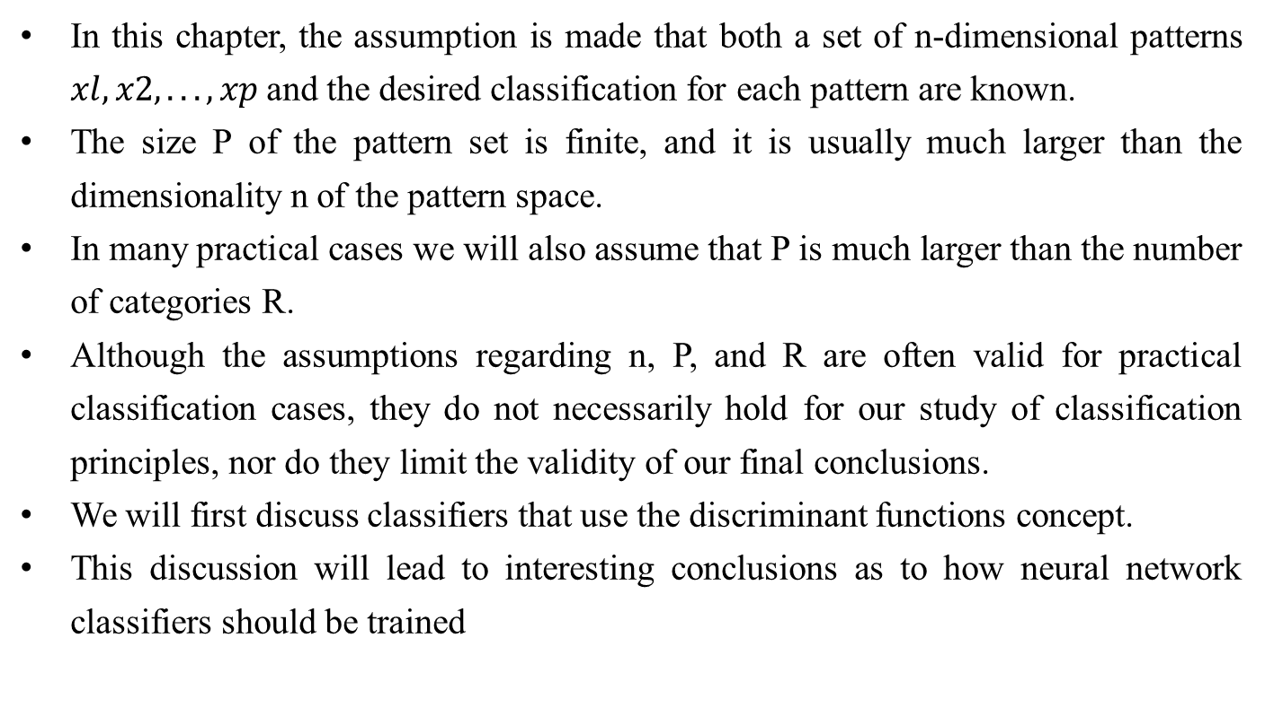
DISCRIMINANT FUNCTIONS
In this chapter, the assumption is made that both a set of n-dimensional patterns $xl, x2, . . . , xp$and the desired classification for each pattern are known.
The size P of the pattern set is finite, and it is usually much larger than the dimensionality n of the pattern space.
In many practical cases we will also assume that P is much larger than the number of categories R.
Although the assumptions regarding n, P, and R are often valid for practical classification cases, they do not necessarily hold for our study of classification principles, nor do they limit the validity of our final conclusions.
We will first discuss classifiers that use the discriminant functions concept.
This discussion will lead to interesting conclusions as to how neural network classifiers should be trained

Slide 12
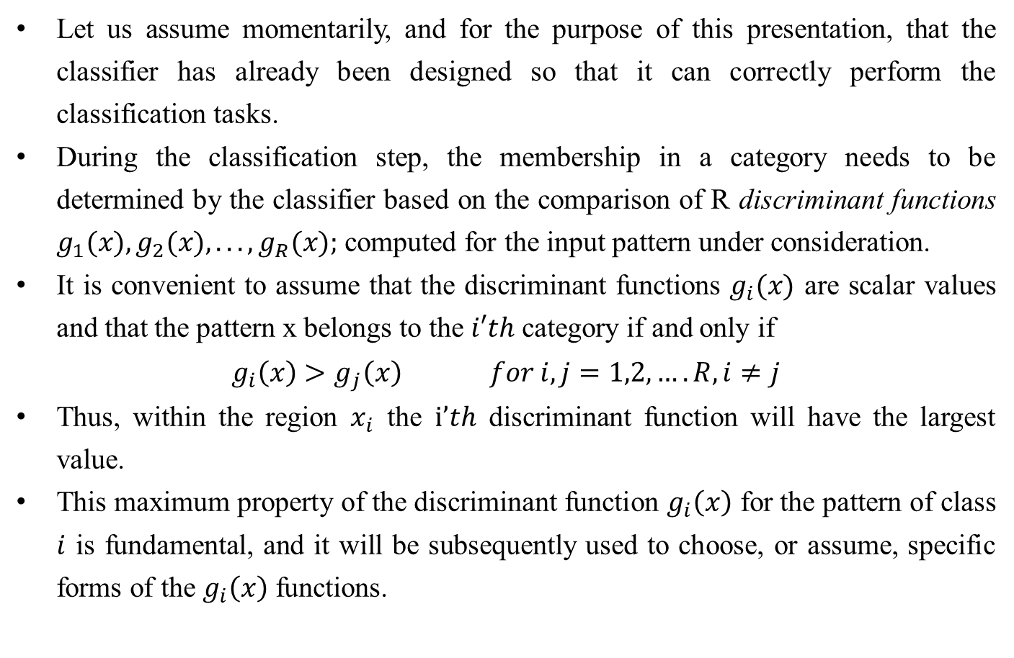
DISCRIMINANT FUNCTIONS
Let us assume momentarily, and for the purpose of this presentation, that the classifier has already been designed so that it can correctly perform the classification tasks.
During the classification step, the membership in a category needs to be determined by the classifier based on the comparison of R discriminant functions $g_{1}(x),g_{2}(x), . . . ,g_{R}(x);$ computed for the input pattern under consideration.
It is convenient to assume that the discriminant functions $g_{i}(x)$ are scalar values and that the pattern x belongs to the $i′th$ category if and only if
$$g_{i}\left(x\right)>g_{j}\left(x\right) for i,j=1,2,….R, i≠j$$
Thus, within the region $x_{i}$ the $i’th$ discriminant function will have the largest value.
This maximum property of the discriminant function $g_{i}\left(x\right)$ for the pattern of class $i$ is fundamental, and it will be subsequently used to choose, or assume, specific forms of the $g_{i}\left(x\right)$ functions.

Slide 13
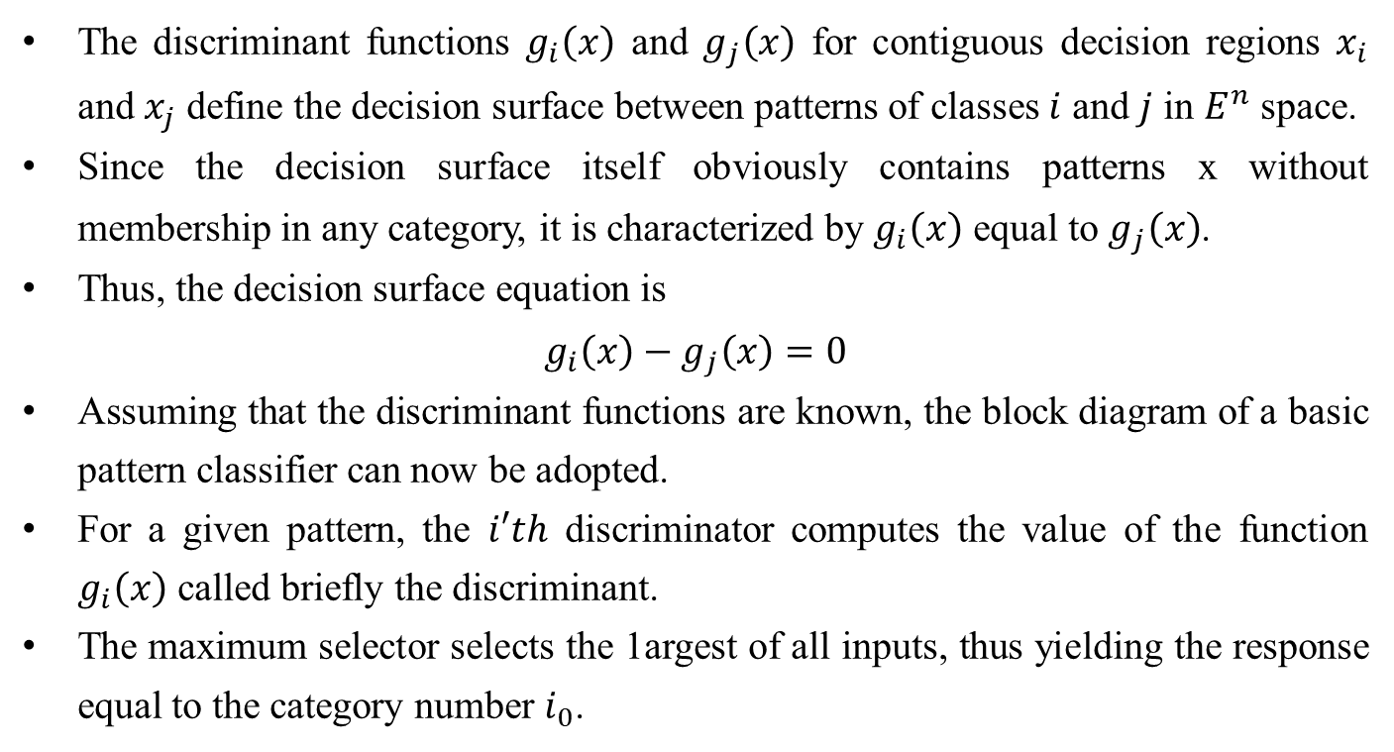
DISCRIMINANT FUNCTIONS
The discriminant functions $g_{i}\left(x\right)$ and $g_{j}\left(x\right)$ for contiguous decision regions $x_{i}$ and $x_{j}$ define the decision surface between patterns of classes $i$ and $j$ in $E^{n}$ space.
Since the decision surface itself obviously contains patterns x without membership in any category, it is characterized by $g_{i}\left(x\right)$ equal to $g_{j}\left(x\right)$.
Thus, the decision surface equation is
$$g_{i}\left(x\right)−g_{j}\left(x\right)=0$$
Assuming that the discriminant functions are known, the block diagram of a basic pattern classifier can now be adopted.
For a given pattern, the $i′th$ discriminator computes the value of the function $g_{i}\left(x\right)$ called briefly the discriminant.
The maximum selector selects the 1argest of all inputs, thus yielding the response equal to the category number $i_{0}$.

Slide 14
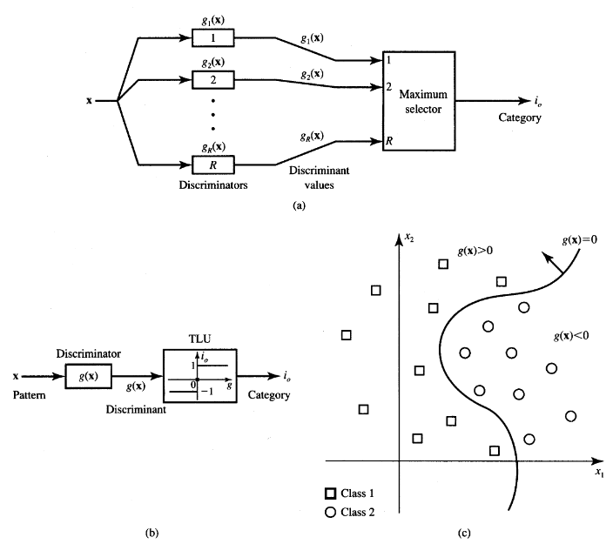
DISCRIMINANT FUNCTIONS

Slide 15
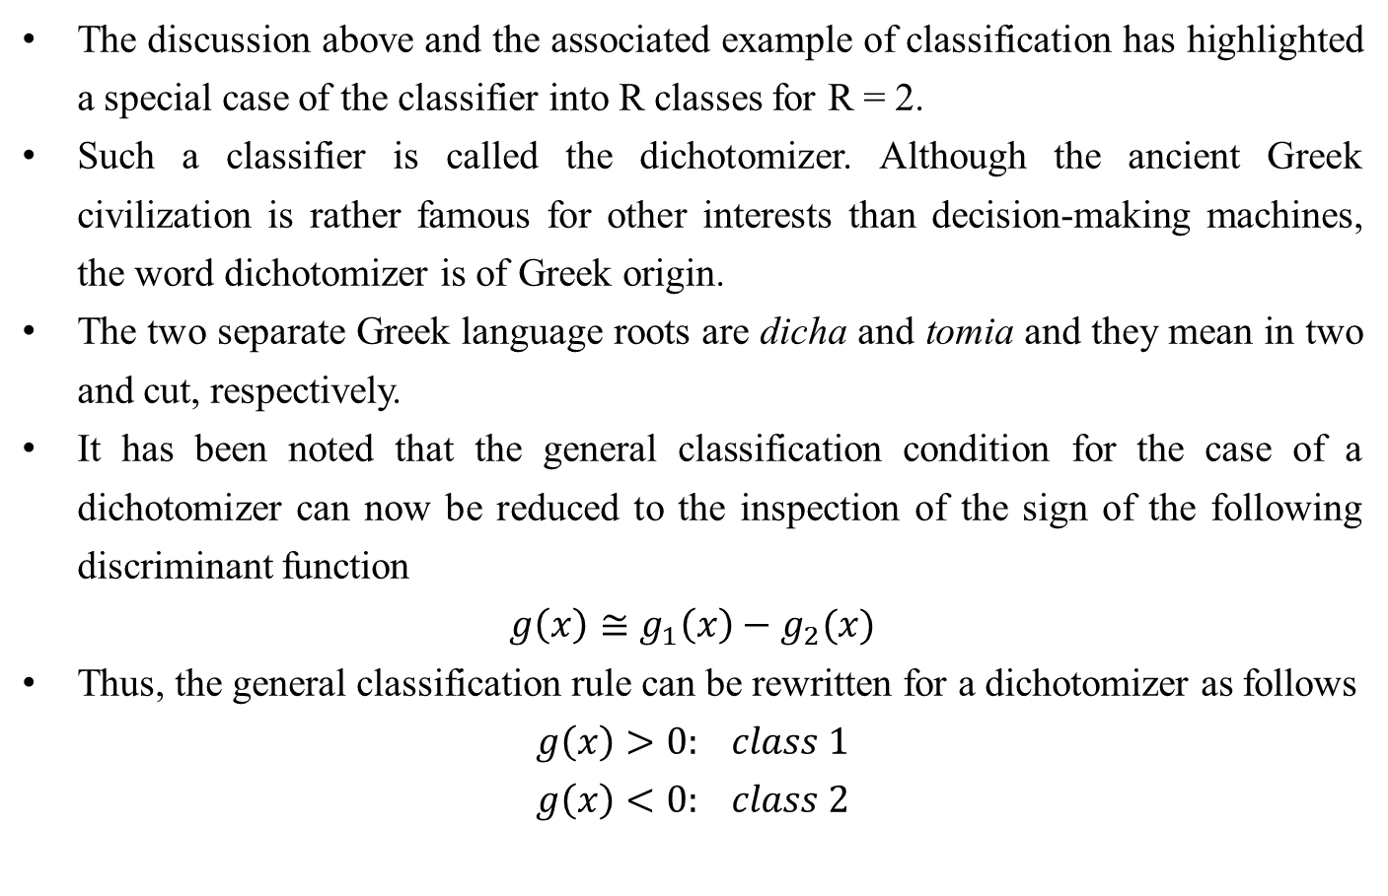
DISCRIMINANT FUNCTIONS
The discussion above and the associated example of classification has highlighted a special case of the classifier into R classes for R = 2.
Such a classifier is called the dichotomizer. Although the ancient Greek civilization is rather famous for other interests than decision-making machines, the word dichotomizer is of Greek origin.
The two separate Greek language roots are dicha and tomia and they mean in two and cut, respectively.
It has been noted that the general classification condition for the case of a dichotomizer can now be reduced to the inspection of the sign of the following discriminant function
$$g\left(x\right)≅g_{1}\left(x\right)−g_{2}(x)$$
Thus, the general classification rule can be rewritten for a dichotomizer as follows
$$g\left(x\right)>0: class 1$$
$$g\left(x\right)<0: class 2$$

Slide 16
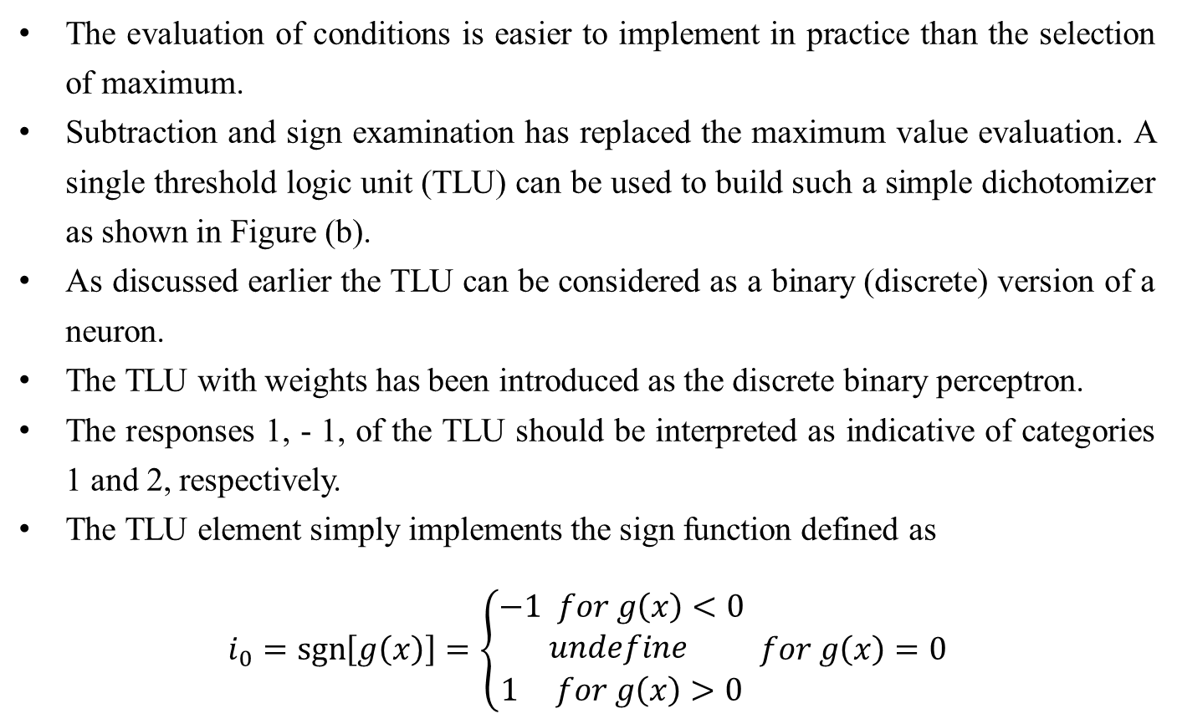
DISCRIMINANT FUNCTIONS
The evaluation of conditions is easier to implement in practice than the selection of maximum.
Subtraction and sign examination has replaced the maximum value evaluation. A single threshold logic unit (TLU) can be used to build such a simple dichotomizer as shown in Figure (b).
As discussed earlier the TLU can be considered as a binary (discrete) version of a neuron.
The TLU with weights has been introduced as the discrete binary perceptron.
The responses 1, - 1, of the TLU should be interpreted as indicative of categories 1 and 2, respectively.
The TLU element simply implements the sign function defined as
$$i_{0}=\operatorname{sgn}\left[g\left(x\right)\right]=\left\{\begin{matrix}−1 for g\left(x\right)<0 \\ undefine \\ 1 for g\left(x\right)>0\end{matrix} for g\left(x\right)=0\right.$$

Slide 17
DISCRIMINANT FUNCTIONS
Once a general functional form of the discriminant functions has been suitably chosen, discriminants can be computed using a priori information about the classification of patterns, provided that such information is available.
In such an approach, the design of a classifier can be based entirely on the computation of decision boundaries as derived from patterns and their membership in classes.
Throughout this chapter and most portions of this book, however, we will focus mainly on classifiers whose decision capabilities are generated from training patterns by means of an iterative learning, or training, algorithm.
Once a type of discriminant function has been assumed, the algorithm of learning functions, provided the training pattern sets are separable by the assumed type of decision function.

Slide 18
DISCRIMINANT FUNCTIONS
For study of such adaptive, or trainable, classifiers the following assumptions are made:
The training pattern set and classification of all its members are known, thus the training is supervised.
The discriminant functions have a linear form and only their coefficients are adjusted in the training procedure.
Under these assumptions, a trainable classifier can be implemented that learns by examples. In this context, we will be interested in input data vectors for which we have a priori knowledge of their correct classification.
These vectors will be referred to as class prototypes or exemplars. The classification problem will then be one c finding decision surfaces, in n-dimensional space, that will enable correct classification of the prototypes and will afford some degree of confidence in correctly recognizing and classifying unknown patterns that have not been used for training.

Slide 19
DISCRIMINANT FUNCTIONS

Slide 20
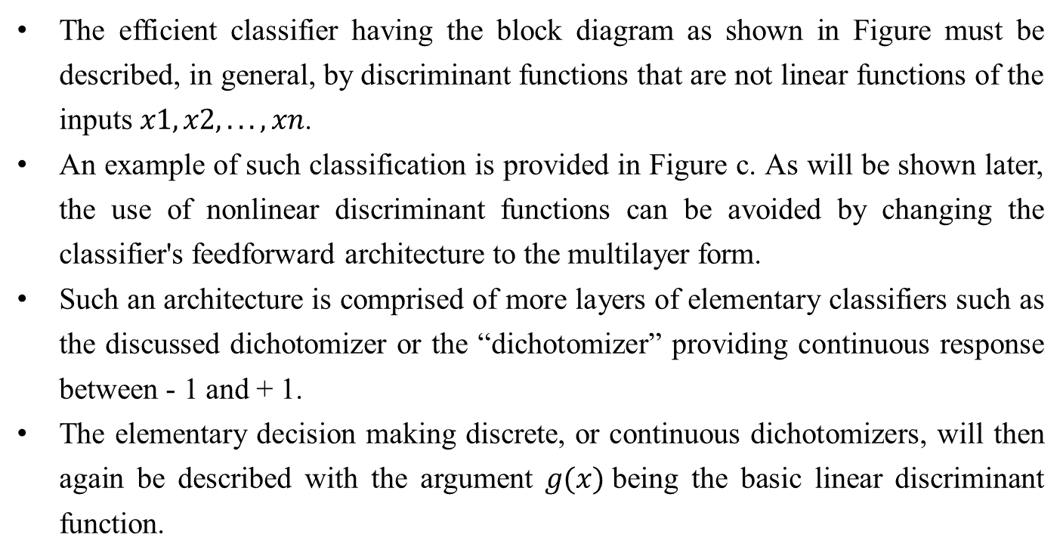
Linear Machine & Minimum Distance Classification
The efficient classifier having the block diagram as shown in Figure must be described, in general, by discriminant functions that are not linear functions of the inputs $x1, x2, . . . , xn$.
An example of such classification is provided in Figure c. As will be shown later, the use of nonlinear discriminant functions can be avoided by changing the classifier's feedforward architecture to the multilayer form.
Such an architecture is comprised of more layers of elementary classifiers such as the discussed dichotomizer or the “dichotomizer” providing continuous response between - 1 and + 1.
The elementary decision making discrete, or continuous dichotomizers, will then again be described with the argument $g(x)$being the basic linear discriminant function.

Slide 21
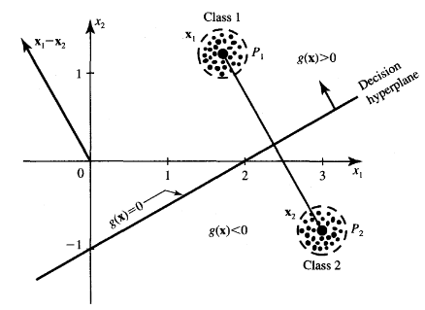
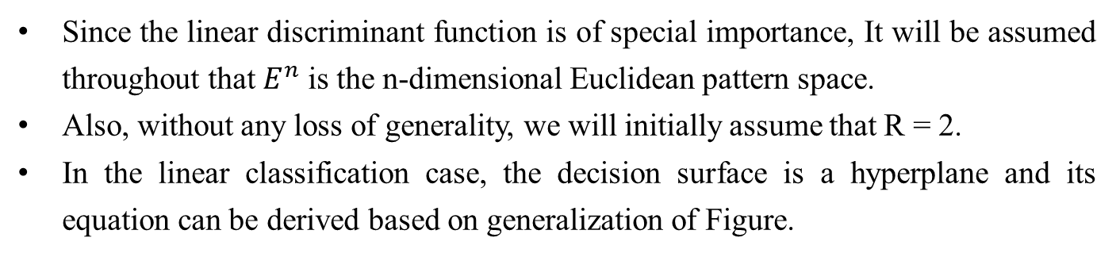
Linear Machine & Minimum Distance Classification
Since the linear discriminant function is of special importance, It will be assumed throughout that $E^{n}$ is the n-dimensional Euclidean pattern space.
Also, without any loss of generality, we will initially assume that R = 2.
In the linear classification case, the decision surface is a hyperplane and its equation can be derived based on generalization of Figure.

Slide 22
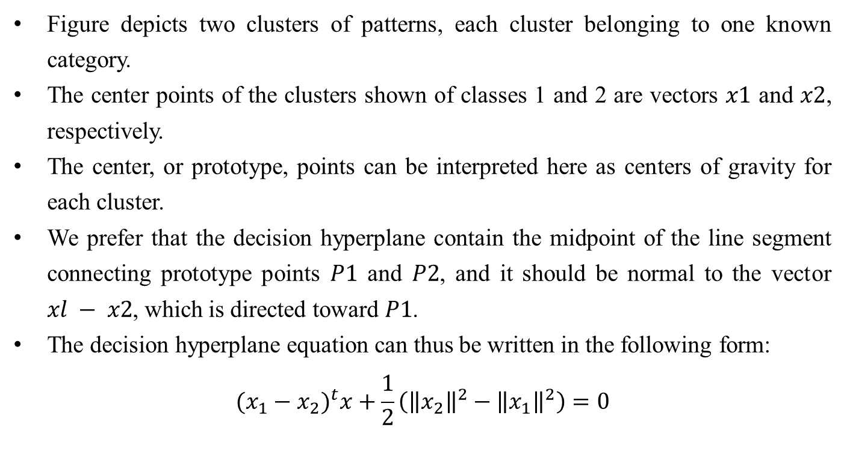
Linear Machine & Minimum Distance Classification
Figure depicts two clusters of patterns, each cluster belonging to one known category.
The center points of the clusters shown of classes 1 and 2 are vectors $x1$ and $x2$, respectively.
The center, or prototype, points can be interpreted here as centers of gravity for each cluster.
We prefer that the decision hyperplane contain the midpoint of the line segment connecting prototype points $P1$ and $P2$, and it should be normal to the vector $xl − x2$, which is directed toward $P1$.
The decision hyperplane equation can thus be written in the following form:
$${(x_{1}−x_{2})}^{t}x+\frac{1}{2}\left({\left\|x_{2}\right\|}^{2}−{\left\|x_{1}\right\|}^{2}\right)=0$$

Slide 23
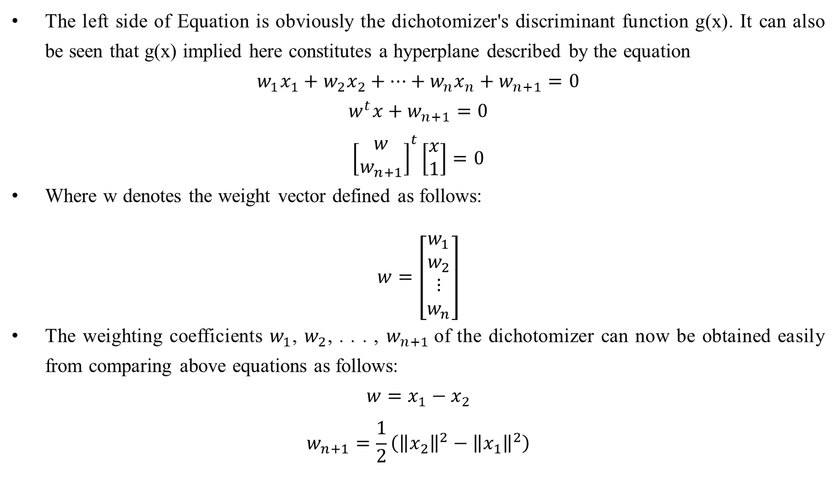
Linear Machine & Minimum Distance Classification
The left side of Equation is obviously the dichotomizer's discriminant function g(x). It can also be seen that g(x) implied here constitutes a hyperplane described by the equation
$$w_{1}x_{1}+w_{2}x_{2}+…+w_{n}x_{n}+w_{n+1}=0$$
$$w^{t}x+w_{n+1}=0$$
$${\left[\begin{matrix}w \\ w_{n+1}\end{matrix}\right]}^{t}\left[\begin{matrix}x \\ 1\end{matrix}\right]=0$$
Where w denotes the weight vector defined as follows:
$$w=\left[\begin{matrix}\begin{matrix}w_{1} \\ w_{2}\end{matrix} \\ ⋮ \\ w_{n}\end{matrix}\right]$$
The weighting coefficients $w_{1}$, $w_{2}$, . . . , $w_{n+1}$of the dichotomizer can now be obtained easily from comparing above equations as follows:
$$w=x_{1}−x_{2}$$
$$w_{n+1}=\frac{1}{2}\left({\left\|x_{2}\right\|}^{2}−{\left\|x_{1}\right\|}^{2}\right)$$

Slide 24
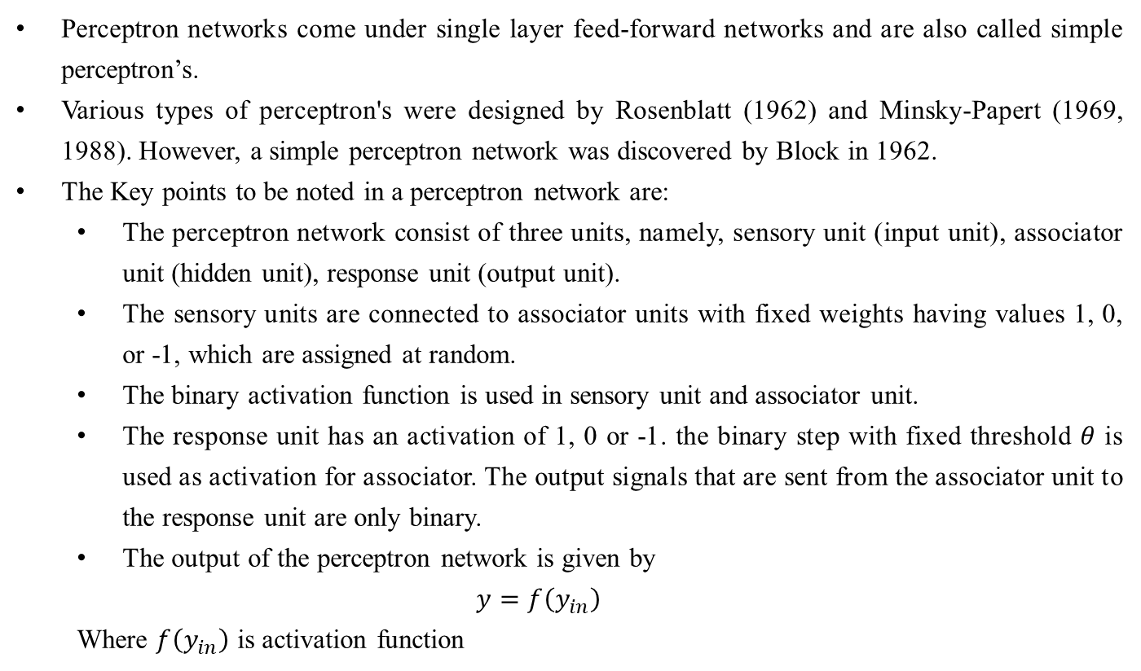
Perceptron Networks
Perceptron networks come under single layer feed-forward networks and are also called simple perceptron’s.
Various types of perceptron's were designed by Rosenblatt (1962) and Minsky-Papert (1969, 1988). However, a simple perceptron network was discovered by Block in 1962.
The Key points to be noted in a perceptron network are:
The perceptron network consist of three units, namely, sensory unit (input unit), associator unit (hidden unit), response unit (output unit).
The sensory units are connected to associator units with fixed weights having values 1, 0, or -1, which are assigned at random.
The binary activation function is used in sensory unit and associator unit.
The response unit has an activation of 1, 0 or -1. the binary step with fixed threshold $θ$ is used as activation for associator. The output signals that are sent from the associator unit to the response unit are only binary.
The output of the perceptron network is given by
$$y=f\left(y_{in}\right)$$
Where $f\left(y_{in}\right)$ is activation function

Slide 25
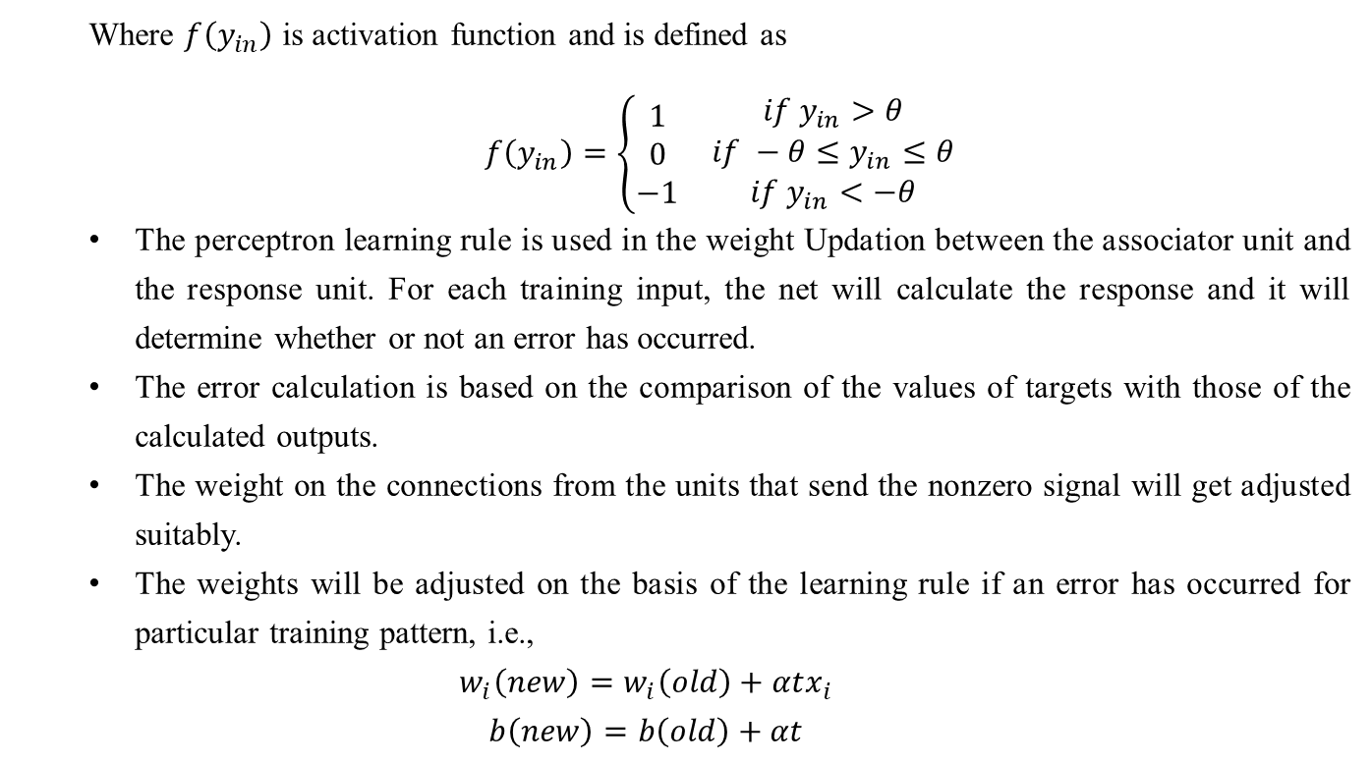
Perceptron Networks
Where $f\left(y_{in}\right)$ is activation function and is defined as
$f\left(y_{in}\right)=\left\{\begin{matrix}\begin{matrix}1 \\ 0 \\ −1\end{matrix} & \begin{matrix}if y_{in}>θ \\ if −θ≤y_{in}≤θ \\ if y_{in}<−θ\end{matrix}\end{matrix}\right.$
The perceptron learning rule is used in the weight Updation between the associator unit and the response unit. For each training input, the net will calculate the response and it will determine whether or not an error has occurred.
The error calculation is based on the comparison of the values of targets with those of the calculated outputs.
The weight on the connections from the units that send the nonzero signal will get adjusted suitably.
The weights will be adjusted on the basis of the learning rule if an error has occurred for particular training pattern, i.e.,
$$w_{i}\left(new\right)=w_{i}\left(old\right)+αtx_{i}$$
$$b\left(new\right)=b\left(old\right)+αt$$

Slide 26
Perceptron Networks
If no error occurs, there is no weight Updation and hence the training process may be stopped.
In the above equations, the target value "t" is +1 or –l and α is the learning rate. In general, these learning rules begin with an initial guess at the weight values and then successive adjustments are made on the basis of the evaluation of an objective function.
Eventually, the learning rules reach a near optimal or optimal solution in a finite number of steps.
A perceptron network with its three units is shown in Figure. As shown in Figure a sensory unit can be a two-dimensional matrix of 400 photodetectors upon which a lighted picture with geometric black and white pattern impinges.
These detectors provide a binary (0) electrical signal if the input signal is found to exceed a certain value of threshold.
Also these detectors are connected randomly with the associator unit. The associator unit is found to consist of a set of subcircuits called feature predicates.
The feature predicates are hard-wired to detect the specific feature of a pattern and are equivalent to the feature detectors. For a particular feature, each predicate is examined with a few or all of the responses of the sensory unit.
It can be found that the results from the predicate units are also binary (0 or 1). The last unit, i.e. response unit, contains the pattern recognizers or perceptron’s. The weights present in the input layers are all fixed, while the weights on the response unit are trainable.

Slide 27
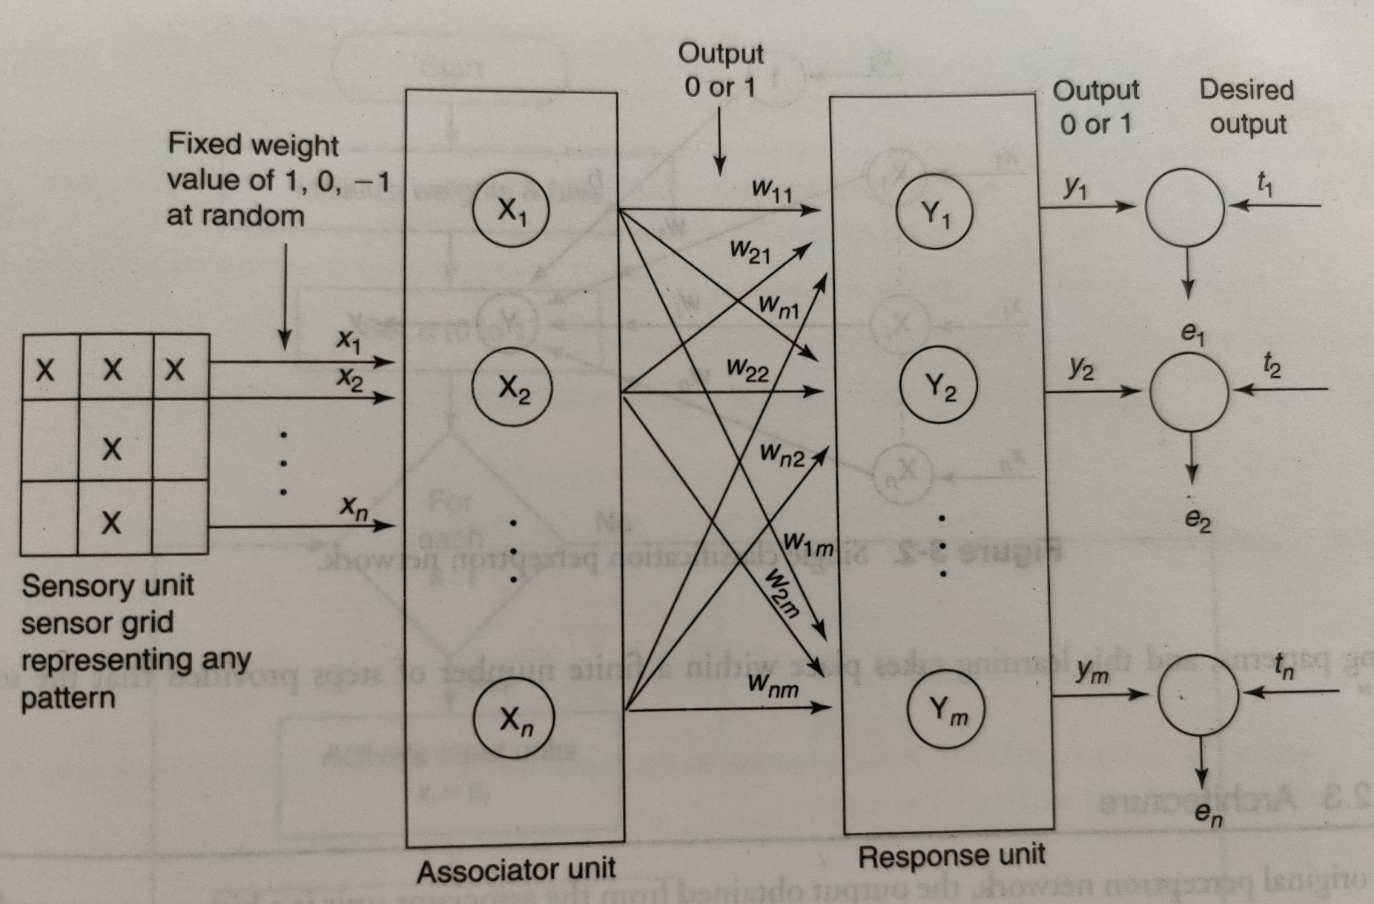

Slide 28
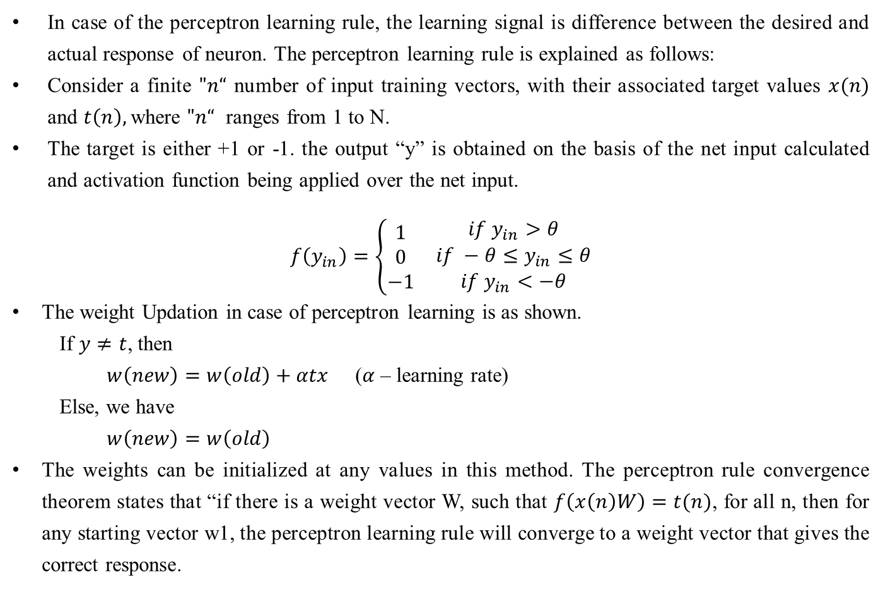
Perceptron Learning Rule
In case of the perceptron learning rule, the learning signal is difference between the desired and actual response of neuron. The perceptron learning rule is explained as follows:
Consider a finite $"n“$ number of input training vectors, with their associated target values $x(n)$ and $t\left(n\right),$where $"n“$ ranges from 1 to N.
The target is either +1 or -1. the output “y” is obtained on the basis of the net input calculated and activation function being applied over the net input.
$$f\left(y_{in}\right)=\left\{\begin{matrix}\begin{matrix}1 \\ 0 \\ −1\end{matrix} & \begin{matrix}if y_{in}>θ \\ if −θ≤y_{in}≤θ \\ if y_{in}<−θ\end{matrix}\end{matrix}\right.$$
The weight Updation in case of perceptron learning is as shown.
If $y≠t$, then
$w\left(new\right)=w\left(old\right)+αtx$ ($α$ – learning rate)
Else, we have
$w\left(new\right)=w\left(old\right)$
The weights can be initialized at any values in this method. The perceptron rule convergence theorem states that “if there is a weight vector W, such that $f\left(x\left(n\right)W\right)=t(n)$, for all n, then for any starting vector w1, the perceptron learning rule will converge to a weight vector that gives the correct response.

Slide 29
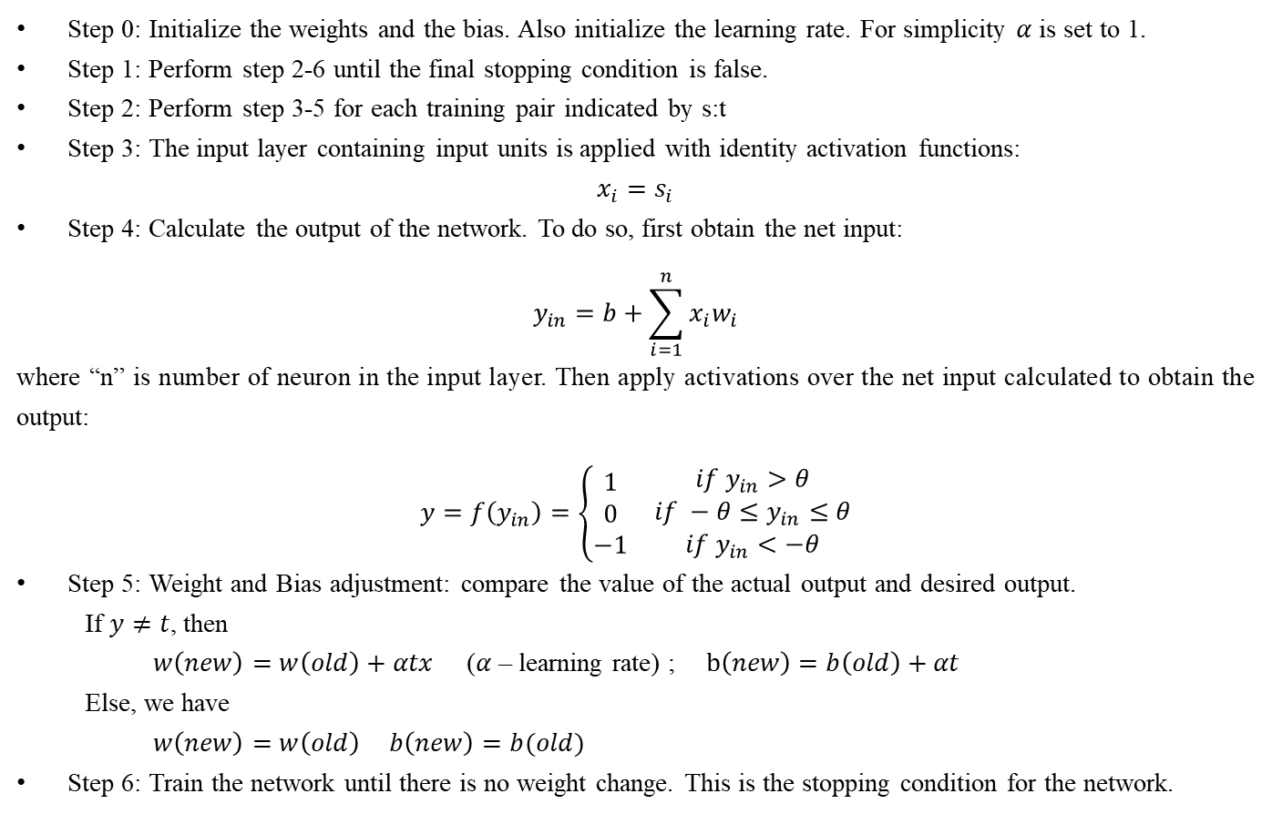
Perceptron Training Algorithm for Single Output class
Step 0: Initialize the weights and the bias. Also initialize the learning rate. For simplicity $α$is set to 1.
Step 1: Perform step 2-6 until the final stopping condition is false.
Step 2: Perform step 3-5 for each training pair indicated by s:t
Step 3: The input layer containing input units is applied with identity activation functions:
$$x_{i}=s_{i}$$
Step 4: Calculate the output of the network. To do so, first obtain the net input:
$$y_{in}=b+\sum_{i=1}^{n}{x_{i}w_{i}}$$
where “n” is number of neuron in the input layer. Then apply activations over the net input calculated to obtain the output:
$$y=f\left(y_{in}\right)=\left\{\begin{matrix}\begin{matrix}1 \\ 0 \\ −1\end{matrix} & \begin{matrix}if y_{in}>θ \\ if −θ≤y_{in}≤θ \\ if y_{in}<−θ\end{matrix}\end{matrix}\right.$$
Step 5: Weight and Bias adjustment: compare the value of the actual output and desired output.
If $y≠t$, then
$w\left(new\right)=w\left(old\right)+αtx$ ($α$ – learning rate) ; $b\left(new\right)=b\left(old\right)+αt$
Else, we have
$w\left(new\right)=w\left(old\right)$ $b\left(new\right)=b(old)$
Step 6: Train the network until there is no weight change. This is the stopping condition for the network.

Slide 30
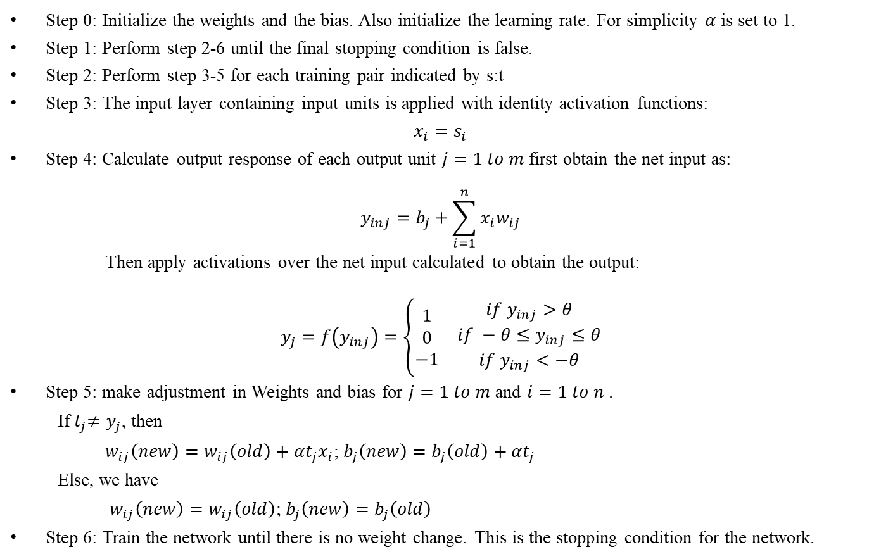
Perceptron Training Algorithm for Multiple Output classes
Step 0: Initialize the weights and the bias. Also initialize the learning rate. For simplicity $α$is set to 1.
Step 1: Perform step 2-6 until the final stopping condition is false.
Step 2: Perform step 3-5 for each training pair indicated by s:t
Step 3: The input layer containing input units is applied with identity activation functions:
$$x_{i}=s_{i}$$
Step 4: Calculate output response of each output unit $j=1 to m$ first obtain the net input as:
$$y_{inj}=b_{j}+\sum_{i=1}^{n}{x_{i}w_{ij}}$$
Then apply activations over the net input calculated to obtain the output:
$$y_{j}=f\left(y_{inj}\right)=\left\{\begin{matrix}\begin{matrix}1 \\ 0 \\ −1\end{matrix} & \begin{matrix}if y_{inj}>θ \\ if −θ≤y_{inj}≤θ \\ if y_{inj}<−θ\end{matrix}\end{matrix}\right.$$
Step 5: make adjustment in Weights and bias for $j=1 to m$ and $i=1 to n$ .
If${ t}_{j}≠y_{j}$, then
$w_{ij}\left(new\right)=w_{ij}\left(old\right)+αt_{j}x_{i}$; $b_{j}\left(new\right)=b_{j}\left(old\right)+αt_{j}$
Else, we have
$w_{ij}\left(new\right)=w_{ij}\left(old\right)$; $b_{j}\left(new\right)=b_{j}\left(old\right)$
Step 6: Train the network until there is no weight change. This is the stopping condition for the network.

Slide 31
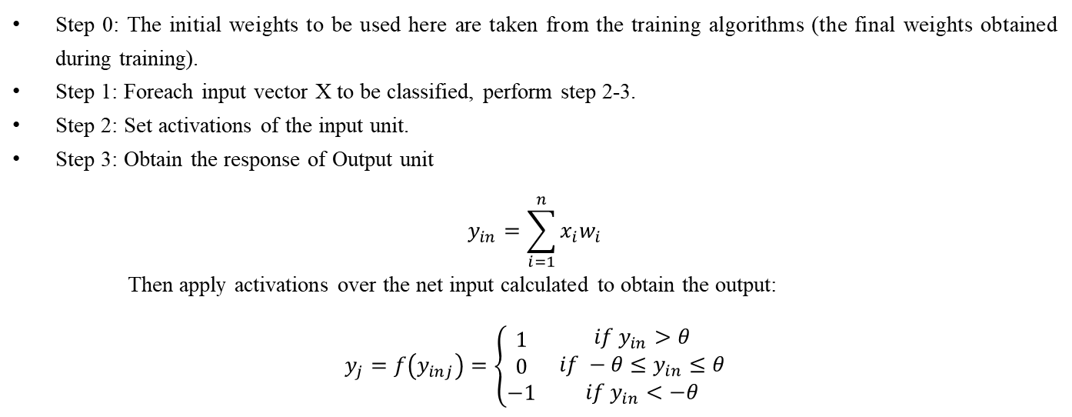
Perceptron network Testing Algorithm
Step 0: The initial weights to be used here are taken from the training algorithms (the final weights obtained during training).
Step 1: Foreach input vector X to be classified, perform step 2-3.
Step 2: Set activations of the input unit.
Step 3: Obtain the response of Output unit
$$y_{in}=\sum_{i=1}^{n}{x_{i}w_{i}}$$
Then apply activations over the net input calculated to obtain the output:
$$y_{j}=f\left(y_{inj}\right)=\left\{\begin{matrix}\begin{matrix}1 \\ 0 \\ −1\end{matrix} & \begin{matrix}if y_{in}>θ \\ if −θ≤y_{in}≤θ \\ if y_{in}<−θ\end{matrix}\end{matrix}\right.$$

Slide 32
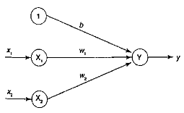
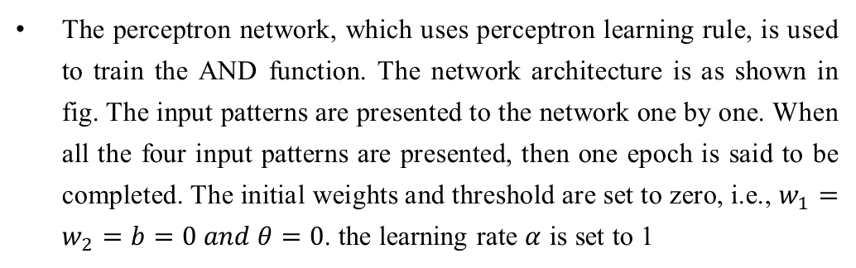
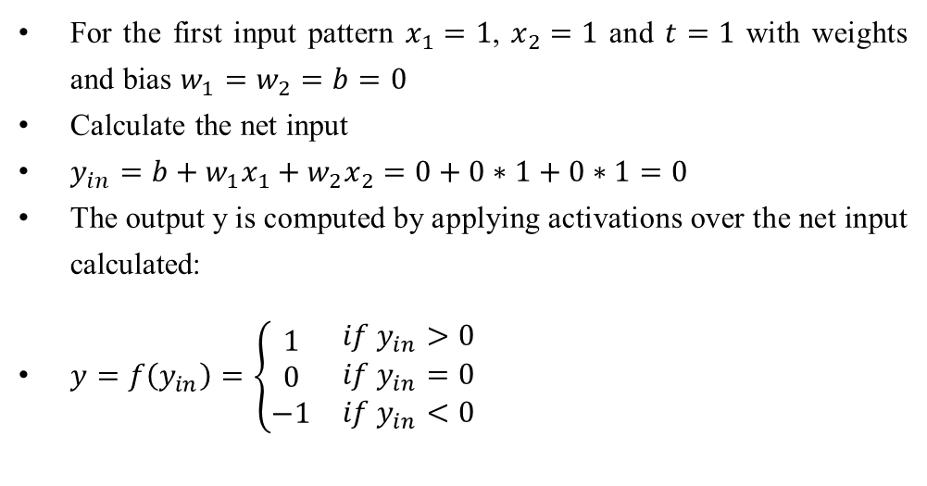
Examples
Implement AND function using perceptron network for bipolar inputs and targets.
Solution:
The perceptron network, which uses perceptron learning rule, is used to train the AND function. The network architecture is as shown in fig. The input patterns are presented to the network one by one. When all the four input patterns are pre­sented, then one epoch is said to be completed. The initial weights and threshold are set to zero, i.e., $w_{1}=w_{2}=b=0 and θ=0$. the learning rate $α$ is set to 1
x1 | x2 | t
1 | 1 | 1
1 | -1 | -1
-1 | 1 | -1
-1 | -1 | -1
For the first input pattern $x_{1}=1$, $x_{2}=1$ and $t=1$ with weights and bias $w_{1}=w_{2}=b=0$
Calculate the net input
$y_{in}=b+w_{1}x_{1}+w_{2}x_{2}=0+0∗1+0∗1=0$
The output y is computed by applying activations over the net input calculated:
$y=f\left(y_{in}\right)=\left\{\begin{matrix}\begin{matrix}1 \\ 0 \\ −1\end{matrix} & \begin{matrix}if y_{in}>0 \\ if y_{in}=0 \\ if y_{in}<0\end{matrix}\end{matrix}\right.$

Slide 33
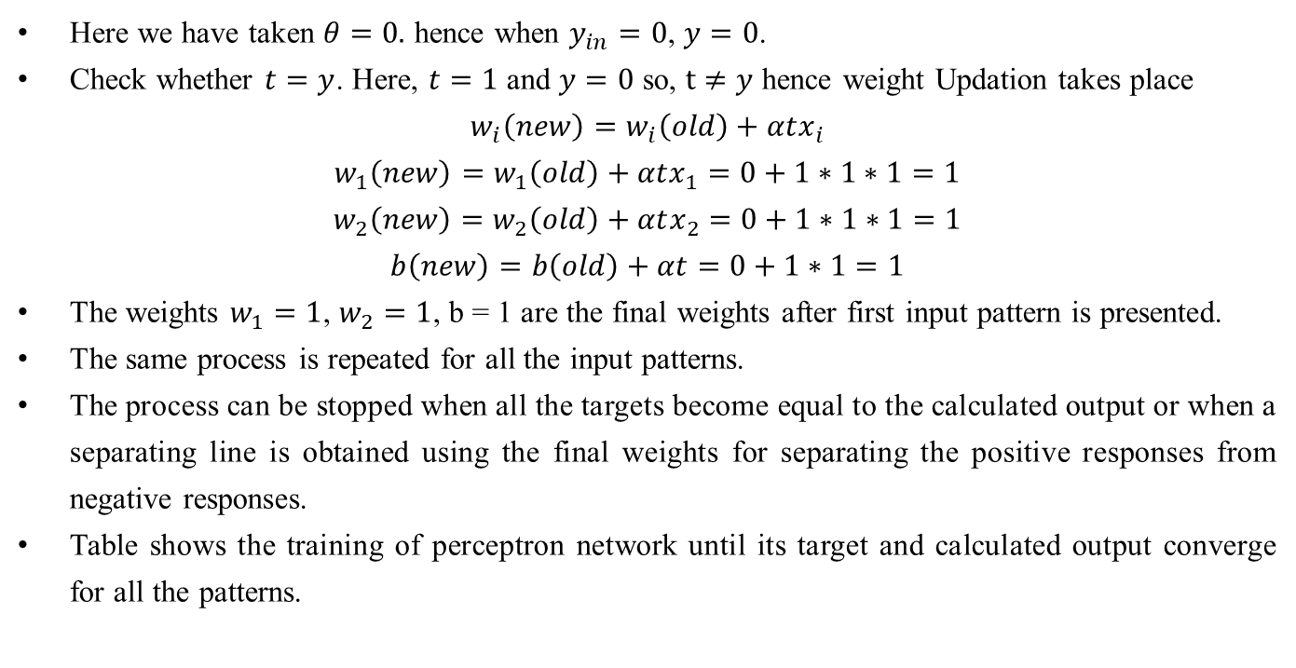
Examples
Here we have taken $θ=0.$ hence when $y_{in}=0$, $y=0$.
Check whether $t=y$. Here, $t=1$ and $y=0$ so, $t≠y$ hence weight Updation takes place
$$w_{i}\left(new\right)=w_{i}\left(old\right)+αtx_{i}$$
$$w_{1}\left(new\right)=w_{1}\left(old\right)+αtx_{1}=0+1∗1∗1=1$$
$$w_{2}\left(new\right)=w_{2}\left(old\right)+αtx_{2}=0+1∗1∗1=1$$
$$b\left(new\right)=b\left(old\right)+αt=0+1∗1=1$$
The weights $w_{1}=1$, $w_{2}=1$, b = 1 are the final weights after first input pattern is presented.
The same process is repeated for all the input patterns.
The pro­cess can be stopped when all the targets become equal to the calculated output or when a separating line is obtained using the final weights for separating the positive responses from negative responses.
Table shows the training of perceptron network until its target and calculated output converge for all the patterns.

Slide 34
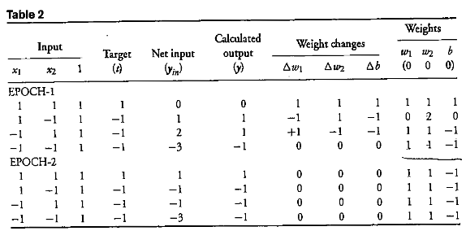
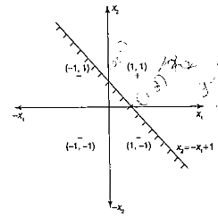
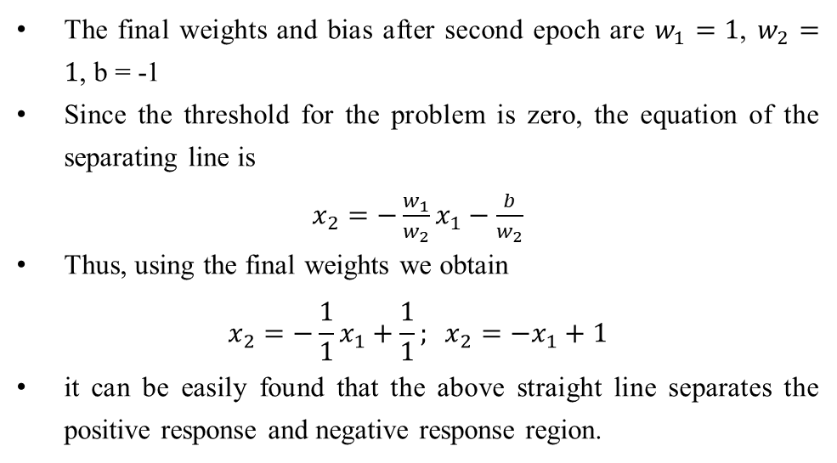
Examples
The final weights and bias after second epoch are $w_{1}=1$, $w_{2}=1$, b = -1
Since the threshold for the problem is zero, the equation of the separating line is
$x_{2}=−\frac{w_{1}}{w_{2}}x_{1}−\frac{b}{w_{2}}$
Thus, using the final weights we obtain
$$x_{2}=−\frac{1}{1}x_{1}+\frac{1}{1}; x_{2}=−x_{1}+1$$
it can be easily found that the above straight line separates the positive response and negative response region.

Slide 35
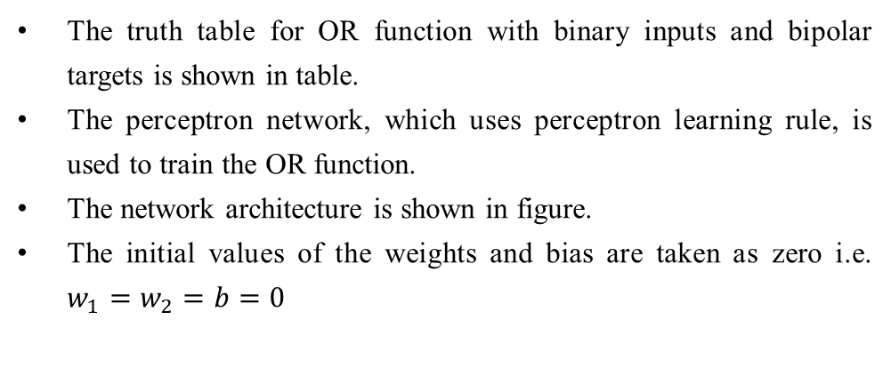
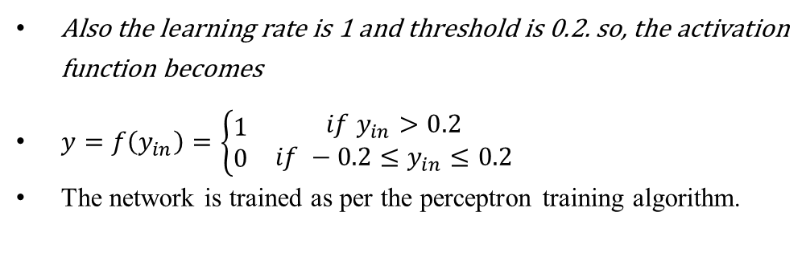
Examples
Implement OR function with binary inputs and bipolar targets using perceptron training algorithm up to 3 epochs.
Solution:
The truth table for OR function with binary inputs and bipolar targets is shown in table.
The perceptron network, which uses perceptron learning rule, is used to train the OR function.
The network architecture is shown in figure.
The initial values of the weights and bias are taken as zero i.e. $w_{1}=w_{2}=b=0$
x1 | x2 | t
1 | 1 | 1
1 | 0 | 1
0 | 1 | 1
0 | 0 | -1
Also the learning rate is 1 and threshold is 0.2. so, the activation function becomes
$y=f\left(y_{in}\right)=\left\{\begin{matrix}\begin{matrix}1 \\ 0\end{matrix} & \begin{matrix}if y_{in}>0.2 \\ if −0.2≤y_{in}≤0.2\end{matrix}\end{matrix}\right.$
The network is trained as per the perceptron training algorithm.

Slide 36
Input |  |  | target | Net input | Calculated output | Weight Changes |  |  | Weights
X1 | X2 | 1 | (t) | (yin) | (y) | ∆w1 | ∆w2 | ∆b | w1 (0) | w2 (0) | b (0)
1 | 1 | 1 | 1 | 0 | 0 | 1 | 1 | 1 | 1 | 1 | 1
1 | 0 | 1 | 1 | 2 | 1 | 0 | 0 | 0 | 1 | 1 | 1
0 | 1 | 1 | 1 | 2 | 1 | 0 | 0 | 0 | 1 | 1 | 1
0 | 0 | 1 | -1 | 1 | 1 | 0 | 0 | -1 | 1 | 1 | 0
1 | 1 | 1 | 1 | 2 | 1 | 0 | 0 | 0 | 1 | 1 | 0
1 | 0 | 1 | 1 | 1 | 1 | 0 | 0 | 0 | 1 | 1 | 0
0 | 1 | 1 | 1 | 1 | 1 | 0 | 0 | 0 | 1 | 1 | 0
0 | 0 | 1 | -1 | 0 | 0 | 0 | 0 | -1 | 1 | 1 | -1
1 | 1 | 1 | 1 | 1 | 1 | 0 | 0 | 0 | 1 | 1 | -1
1 | 0 | 1 | 1 | 0 | 0 | 1 | 0 | 1 | 2 | 1 | 0
0 | 1 | 1 | 1 | 1 | 1 | 0 | 0 | 0 | 2 | 1 | 0
0 | 0 | 1 | -1 | 0 | 0 | 0 | 0 | -1 | 2 | 1 | -1

Slide 37
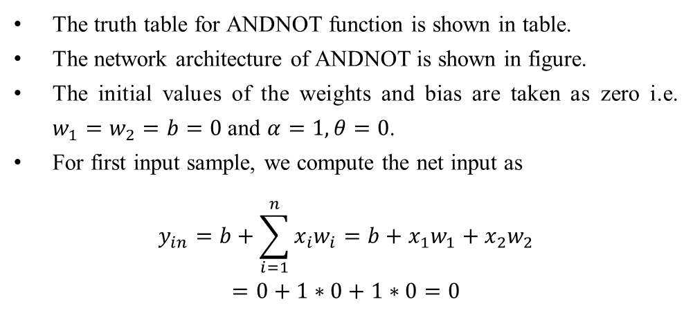
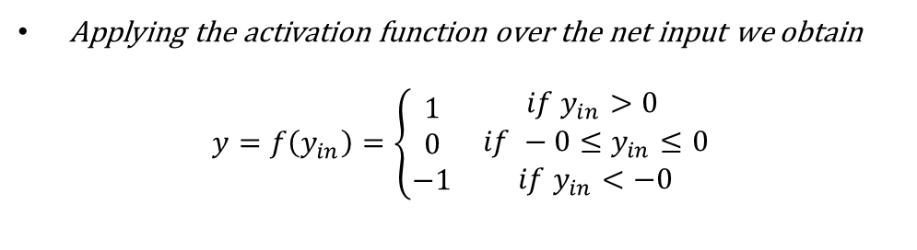
Examples
Find the weights using perceptron network for ANDNOT function when all the inputs are presented only one time. Use bipolar inputs and targets.
Solution:
The truth table for ANDNOT function is shown in table.
The network architecture of ANDNOT is shown in figure.
The initial values of the weights and bias are taken as zero i.e. $w_{1}=w_{2}=b=0$ and $α=1, θ=0$.
For first input sample, we compute the net input as
$$y_{in}=b+\sum_{i=1}^{n}{x_{i}w_{i}}=b+x_{1}w_{1}+x_{2}w_{2}$$
$$=0+1∗0+1∗0=0$$
x1 | x2 | t
1 | 1 | -1
1 | -1 | 1
-1 | 1 | -1
-1 | -1 | -1
Applying the activation function over the net input we obtain
$$y=f\left(y_{in}\right)=\left\{\begin{matrix}\begin{matrix}1 \\ 0 \\ −1\end{matrix} & \begin{matrix}if y_{in}>0 \\ if −0≤y_{in}≤0 \\ if y_{in}<−0\end{matrix}\end{matrix}\right.$$

Slide 38
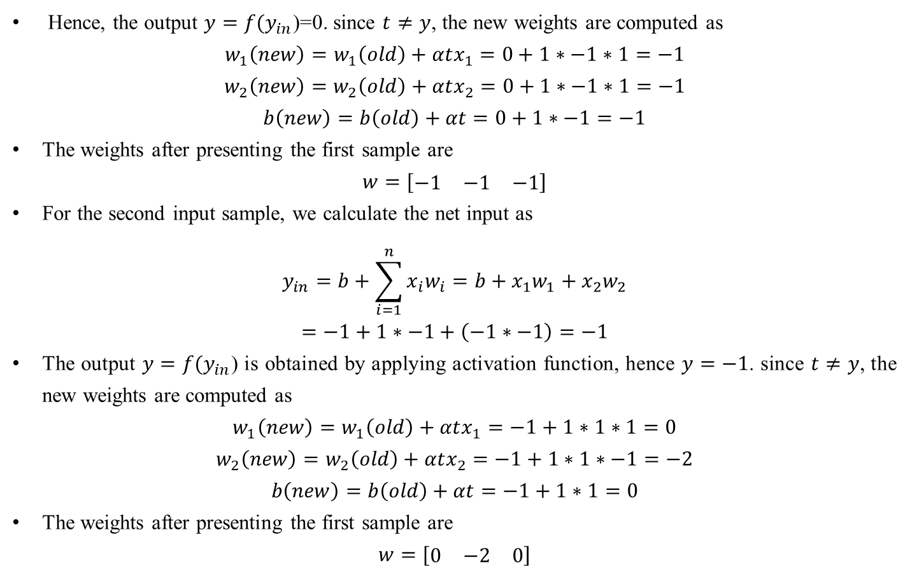
Examples
Hence, the output $y=f(y_{in}$)=0. since $t≠y$, the new weights are computed as
$$w_{1}\left(new\right)=w_{1}\left(old\right)+αtx_{1}=0+1∗−1∗1=−1$$
$$w_{2}\left(new\right)=w_{2}\left(old\right)+αtx_{2}=0+1∗−1∗1=−1$$
$$b\left(new\right)=b\left(old\right)+αt=0+1∗−1=−1$$
The weights after presenting the first sample are
$$w=[\begin{matrix}−1 & −1 & −1\end{matrix}]$$
For the second input sample, we calculate the net input as
$$y_{in}=b+\sum_{i=1}^{n}{x_{i}w_{i}}=b+x_{1}w_{1}+x_{2}w_{2}$$
$$=−1+1∗−1+\left(−1∗−1\right)=−1$$
The output $y=f(y_{in}$) is obtained by applying activation function, hence $y=−1$. since $t≠y$, the new weights are computed as
$$w_{1}\left(new\right)=w_{1}\left(old\right)+αtx_{1}=−1+1∗1∗1=0$$
$$w_{2}\left(new\right)=w_{2}\left(old\right)+αtx_{2}=−1+1∗1∗−1=−2$$
$$b\left(new\right)=b\left(old\right)+αt=−1+1∗1=0$$
The weights after presenting the first sample are
$$w=[\begin{matrix}0 & −2 & 0\end{matrix}]$$

Slide 39
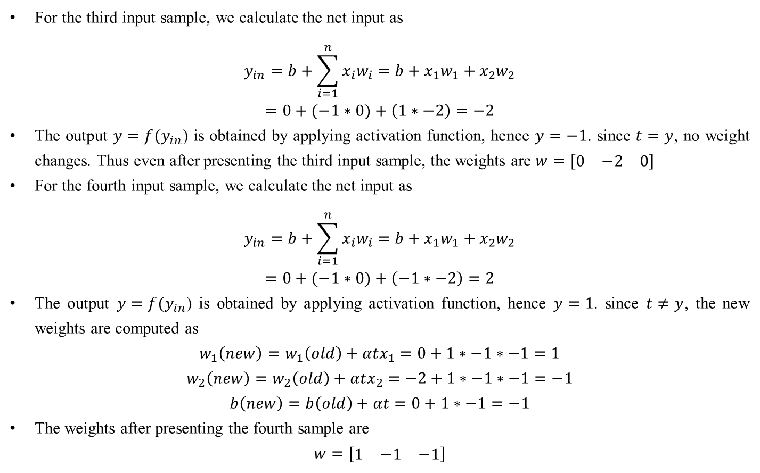
Examples
For the third input sample, we calculate the net input as
$$y_{in}=b+\sum_{i=1}^{n}{x_{i}w_{i}}=b+x_{1}w_{1}+x_{2}w_{2}$$
$$=0+(−1∗0)+\left(1∗−2\right)=−2$$
The output $y=f(y_{in}$) is obtained by applying activation function, hence $y=−1$. since $t=y$, no weight changes. Thus even after presenting the third input sample, the weights are $w=[\begin{matrix}0 & −2 & 0\end{matrix}]$
For the fourth input sample, we calculate the net input as
$$y_{in}=b+\sum_{i=1}^{n}{x_{i}w_{i}}=b+x_{1}w_{1}+x_{2}w_{2}$$
$$=0+(−1∗0)+\left(−1∗−2\right)=2$$
The output $y=f(y_{in}$) is obtained by applying activation function, hence $y=1$. since $t≠y$, the new weights are computed as
$$w_{1}\left(new\right)=w_{1}\left(old\right)+αtx_{1}=0+1∗−1∗−1=1$$
$$w_{2}\left(new\right)=w_{2}\left(old\right)+αtx_{2}=−2+1∗−1∗−1=−1$$
$$b\left(new\right)=b\left(old\right)+αt=0+1∗−1=−1$$
The weights after presenting the fourth sample are
$$w=[\begin{matrix}1 & −1 & −1\end{matrix}]$$

Slide 40
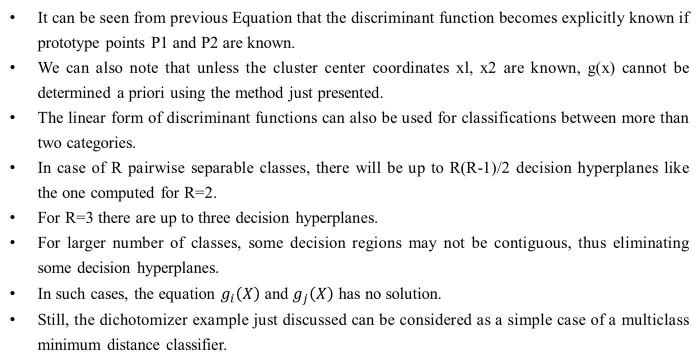
Training & Classification using Discrete Perceptron
It can be seen from previous Equation that the discriminant function becomes explicitly known if prototype points P1 and P2 are known.
We can also note that unless the cluster center coordinates xl, x2 are known, g(x) cannot be determined a priori using the method just presented.
The linear form of discriminant functions can also be used for classifications between more than two categories.
In case of R pairwise separable classes, there will be up to R(R-1)/2 decision hyperplanes like the one computed for R=2.
For R=3 there are up to three decision hyperplanes.
For larger number of classes, some decision regions may not be contiguous, thus eliminating some decision hyperplanes.
In such cases, the equation $g_{i}\left(X\right)$ and $g_{j}\left(X\right)$ has no solution.
Still, the dichotomizer example just discussed can be considered as a simple case of a multiclass minimum distance classifier.

Slide 41
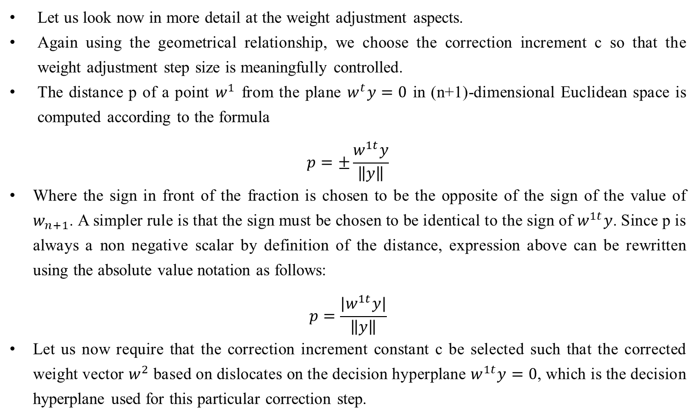
Training & Classification using Discrete Perceptron: Algorithm and Example
Let us look now in more detail at the weight adjustment aspects.
Again using the geometrical relationship, we choose the correction increment c so that the weight adjustment step size is meaningfully controlled.
The distance p of a point $w^{1}$ from the plane $w^{t}y=0$ in (n+1)-dimensional Euclidean space is computed according to the formula
$$p=±\frac{w^{1t}y}{\left\|y\right\|}$$
Where the sign in front of the fraction is chosen to be the opposite of the sign of the value of $w_{n+1}$. A simpler rule is that the sign must be chosen to be identical to the sign of $w^{1t}y$. Since p is always a non negative scalar by definition of the distance, expression above can be rewritten using the absolute value notation as follows:
$$p=\frac{|w^{1t}y|}{\left\|y\right\|}$$
Let us now require that the correction increment constant c be selected such that the corrected weight vector $w^{2}$ based on dislocates on the decision hyperplane $w^{1t}y=0$, which is the decision hyperplane used for this particular correction step.

Slide 42
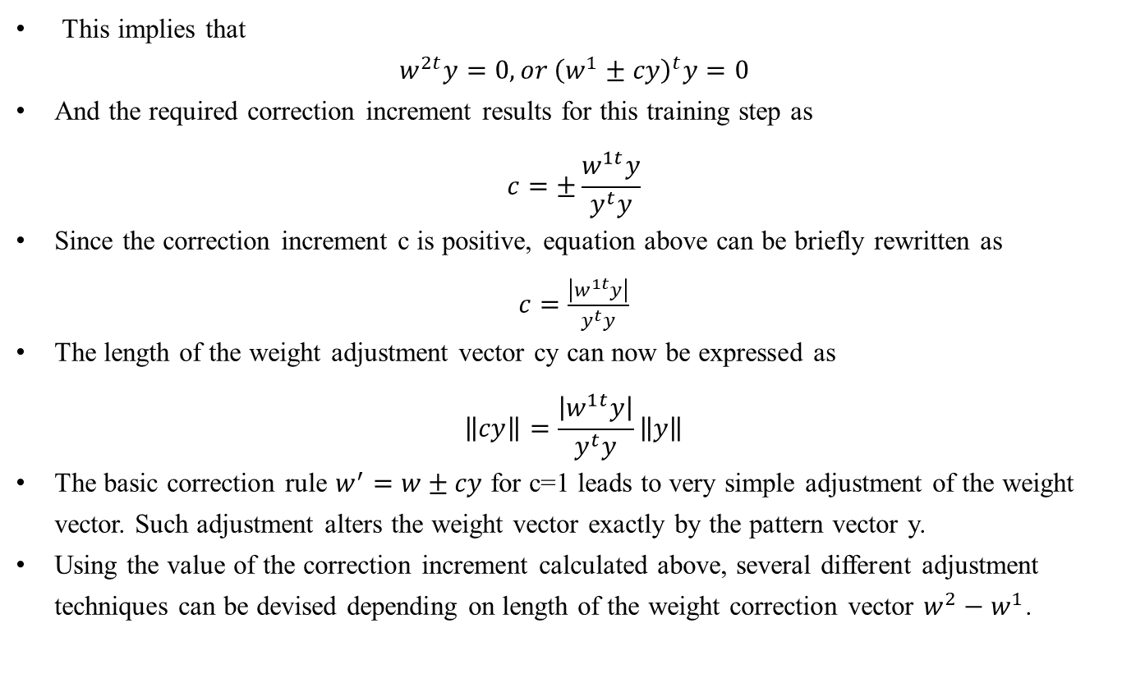
Training & Classification using Discrete Perceptron: Algorithm and Example
This implies that
$$w^{2t}y=0, or {\left(w^{1}±cy\right)}^{t}y=0$$
And the required correction increment results for this training step as
$$c=±\frac{w^{1t}y}{y^{t}y}$$
Since the correction increment c is positive, equation above can be briefly rewritten as
$c=\frac{\left|w^{1t}y\right|}{y^{t}y}$
The length of the weight adjustment vector cy can now be expressed as
$$\left\|cy\right\|=\frac{\left|w^{1t}y\right|}{y^{t}y}\left\|y\right\|$$
The basic correction rule $w^{′}=w±cy$ for c=1 leads to very simple adjustment of the weight vector. Such adjustment alters the weight vector exactly by the pattern vector y.
Using the value of the correction increment calculated above, several different adjustment techniques can be devised depending on length of the weight correction vector $w^{2}−w^{1}$.

Slide 43
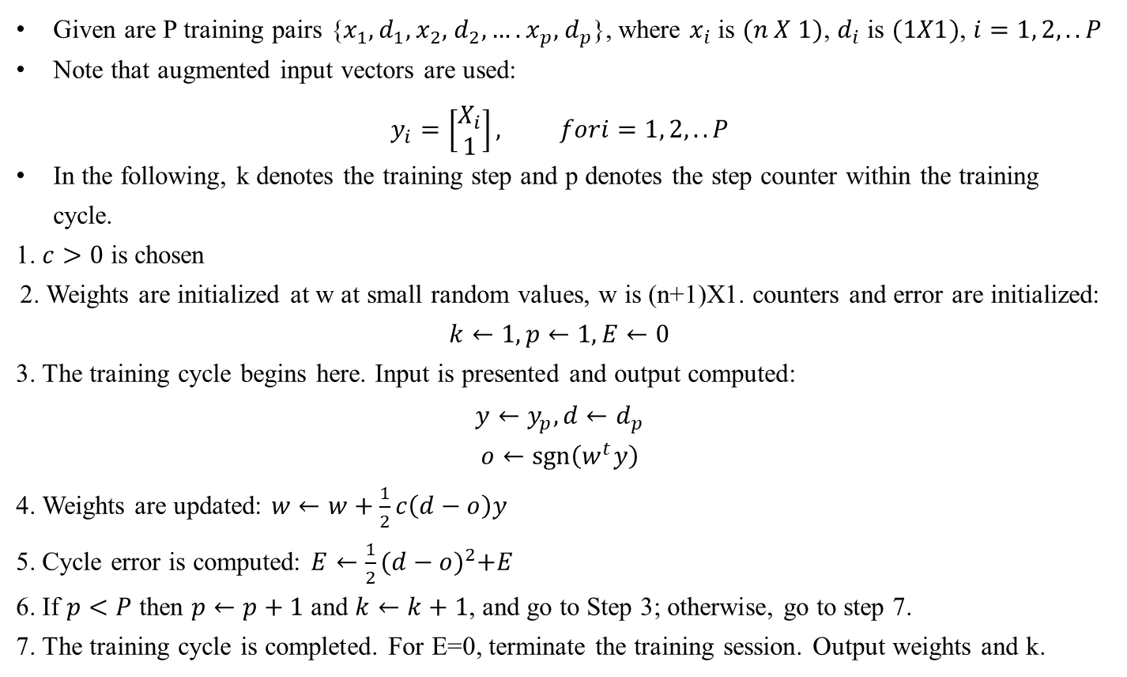
Training & Classification using Discrete Perceptron: Algorithm and Example
Given are P training pairs {$x_{1},d_{1},$ $x_{2},$ $d_{2},….$ $x_{p},$ $d_{p}$}, where $x_{i}$ is $(n X 1)$, $d_{i}$ is $(1X1)$, $i=1, 2,..P$
Note that augmented input vectors are used:
$$y_{i}=\left[\begin{matrix}X_{i} \\ 1\end{matrix}\right], fori=1, 2,..P$$
In the following, k denotes the training step and p denotes the step counter within the training cycle.
1. $c>0$ is chosen
2. Weights are initialized at w at small random values, w is (n+1)X1. counters and error are initialized: $k←1,p←1,E←0$
3. The training cycle begins here. Input is presented and output computed:
$y←y_{p}, d←d_{p}$
$$o←\operatorname{sgn}\left(w^{t}y\right)$$
4. Weights are updated: $w←w+\frac{1}{2}c\left(d−o\right)y$
5. Cycle error is computed: $E←\frac{1}{2}{(d−o)}^{2}+E$
6. If $p<P$ then $p←p+1$ and $k←k+1$, and go to Step 3; otherwise, go to step 7.
7. The training cycle is completed. For E=0, terminate the training session. Output weights and k.

Slide 44
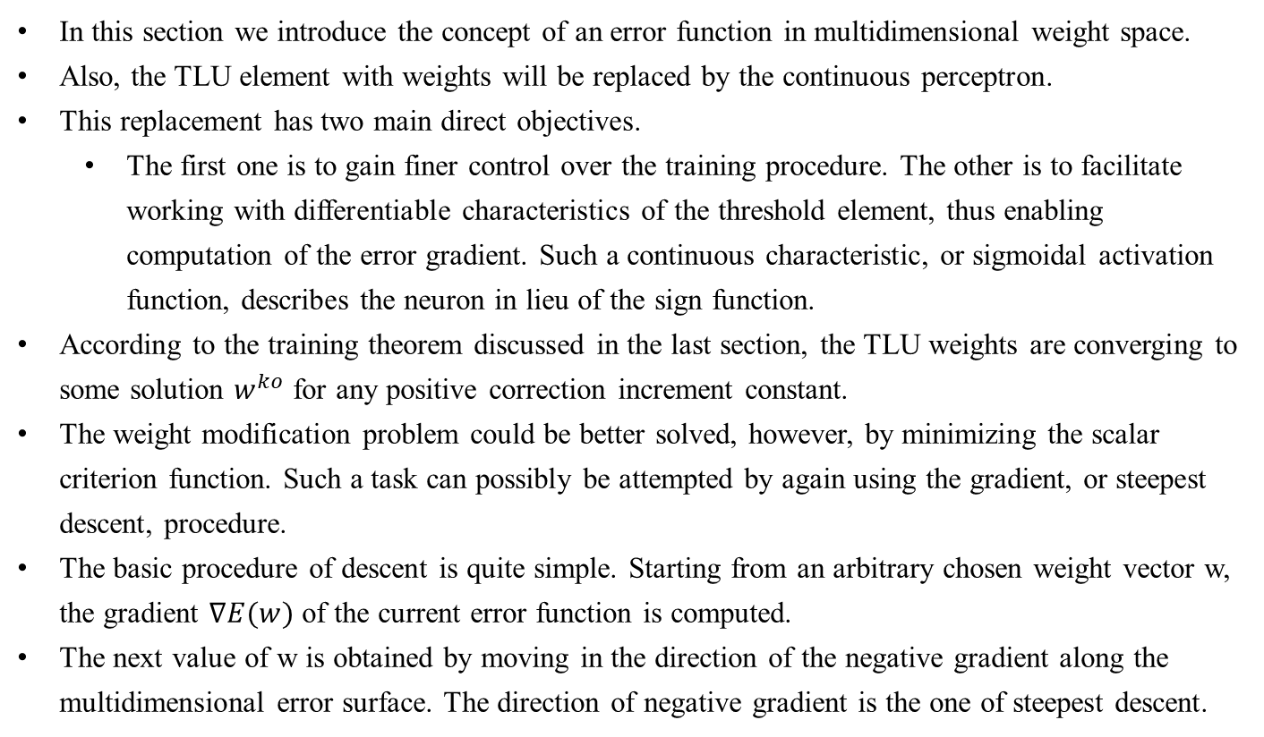
Single Layer continuous perceptron network for linearly separable classification
In this section we introduce the concept of an error function in multidimensional weight space.
Also, the TLU element with weights will be replaced by the continuous perceptron.
This replacement has two main direct objectives.
The first one is to gain finer control over the training procedure. The other is to facilitate working with differentiable characteristics of the threshold element, thus enabling computation of the error gradient. Such a continuous characteristic, or sigmoidal activation function, describes the neuron in lieu of the sign function.
According to the training theorem discussed in the last section, the TLU weights are converging to some solution $w^{ko}$ for any positive correction increment constant.
The weight modification problem could be better solved, however, by minimizing the scalar criterion function. Such a task can possibly be attempted by again using the gradient, or steepest descent, procedure.
The basic procedure of descent is quite simple. Starting from an arbitrary chosen weight vector w, the gradient $∇E(w)$ of the current error function is computed.
The next value of w is obtained by moving in the direction of the negative gradient along the multidimensional error surface. The direction of negative gradient is the one of steepest descent.

Slide 45
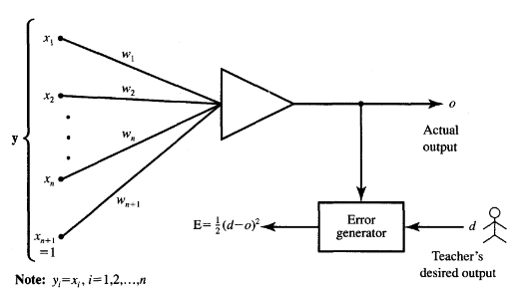
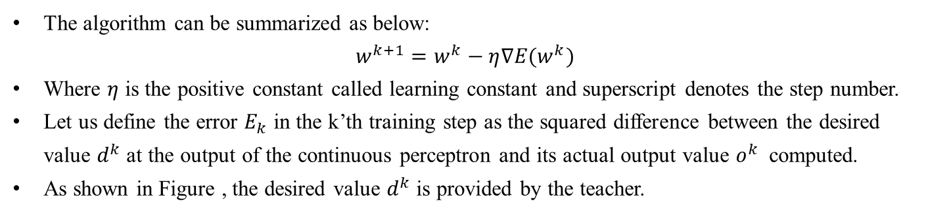
Single Layer continuous perceptron network for linearly separable classification
The algorithm can be summarized as below:
$$w^{k+1}=w^{k}−η∇E(w^{k})$$
Where $η$ is the positive constant called learning constant and superscript denotes the step number.
Let us define the error $E_{k}$ in the k’th training step as the squared difference between the desired value $d^{k}$ at the output of the continuous perceptron and its actual output value $o^{k}$ computed.
As shown in Figure , the desired value $d^{k}$ is provided by the teacher.

Slide 46
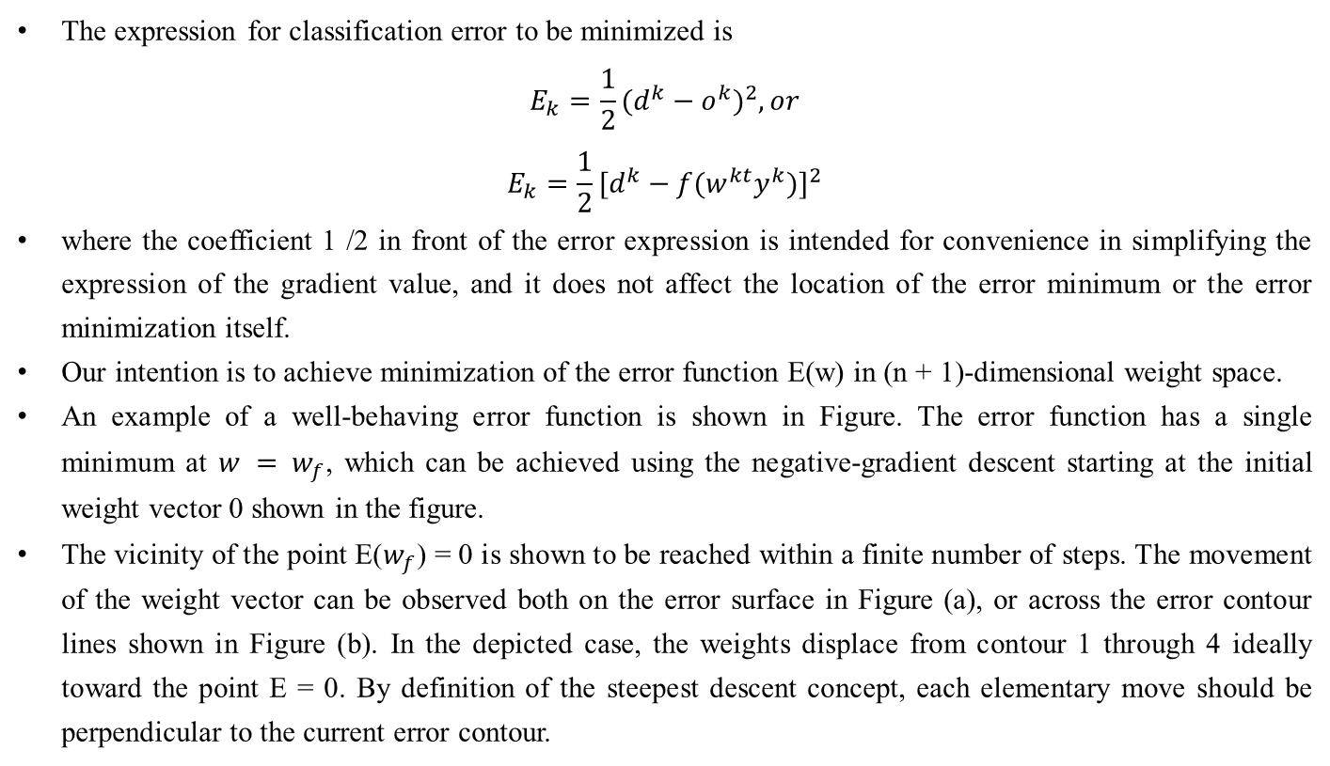
Single Layer continuous perceptron network for linearly separable classification
The expression for classification error to be minimized is
$$E_{k}=\frac{1}{2}{(d^{k}−o^{k})}^{2}, or$$
$$E_{k}=\frac{1}{2}{[d^{k}−f(w^{kt}y^{k})]}^{2}$$
where the coefficient 1 /2 in front of the error expression is intended for convenience in simplifying the expression of the gradient value, and it does not affect the location of the error minimum or the error minimization itself.
Our intention is to achieve minimization of the error function E(w) in (n + 1)-dimensional weight space.
An example of a well-behaving error function is shown in Figure. The error function has a single minimum at $w = w_{f}$, which can be achieved using the negative-gradient descent starting at the initial weight vector 0 shown in the figure.
The vicinity of the point E($w_{f}$) = 0 is shown to be reached within a finite number of steps. The movement of the weight vector can be observed both on the error surface in Figure (a), or across the error contour lines shown in Figure (b). In the depicted case, the weights displace from contour 1 through 4 ideally toward the point E = 0. By definition of the steepest descent concept, each elementary move should be perpendicular to the current error contour.

Slide 47
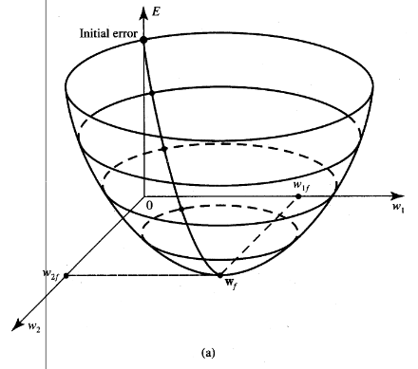
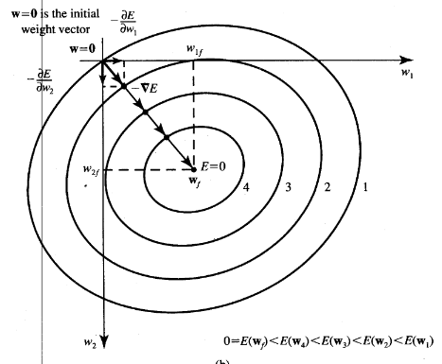
Single Layer continuous perceptron network for linearly separable classification

Slide 48
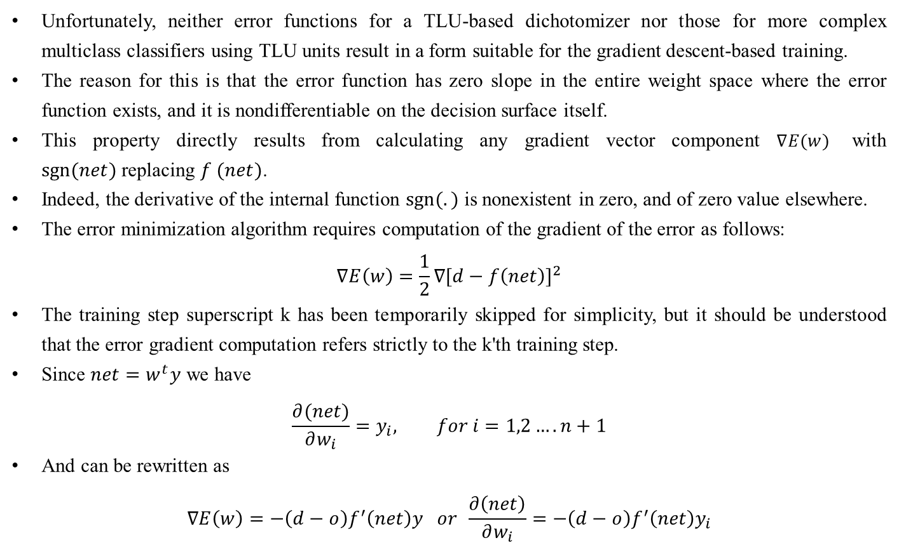
Single Layer continuous perceptron network for linearly separable classification
Unfortunately, neither error functions for a TLU-based dichotomizer nor those for more complex multiclass classifiers using TLU units result in a form suitable for the gradient descent-based training.
The reason for this is that the error function has zero slope in the entire weight space where the error function exists, and it is nondifferentiable on the decision surface itself.
This property directly results from calculating any gradient vector component $∇E(w)$ with $sgn⁡(net)$replacing $f (net)$.
Indeed, the derivative of the internal function $sgn⁡(.)$ is nonexistent in zero, and of zero value elsewhere.
The error minimization algorithm requires computation of the gradient of the error as follows:
$$∇E\left(w\right)=\frac{1}{2}∇{[d−f\left(net\right)]}^{2}$$
The training step superscript k has been temporarily skipped for simplicity, but it should be understood that the error gradient computation refers strictly to the k'th training step.
Since $net=w^{t}y$ we have
$$\frac{∂(net)}{∂w_{i}}=y_{i}, for i=1,2….n+1$$
And can be rewritten as
$$∇E\left(w\right)=−\left(d−o\right)f^{′}\left(net\right)y or \frac{∂\left(net\right)}{∂w_{i}}=−\left(d−o\right)f^{′}\left(net\right)y_{i}$$

Slide 49
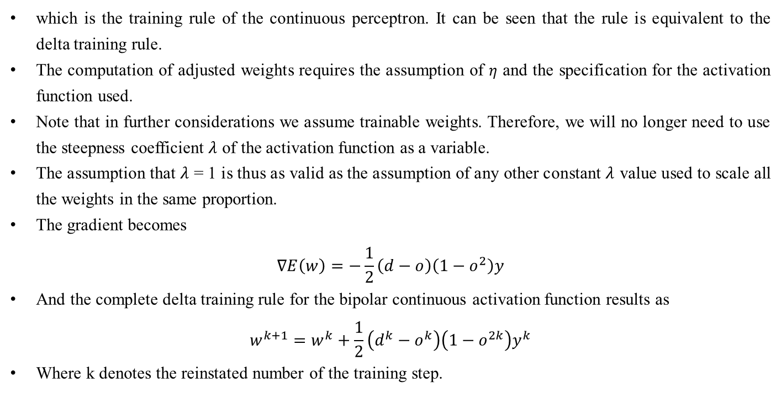
Single Layer continuous perceptron network for linearly separable classification
which is the training rule of the continuous perceptron. It can be seen that the rule is equivalent to the delta training rule.
The computation of adjusted weights requires the assumption of $η$ and the specification for the activation function used.
Note that in further considerations we assume trainable weights. Therefore, we will no longer need to use the steepness coefficient $λ$ of the activation function as a variable.
The assumption that $λ$ = 1 is thus as valid as the assumption of any other constant $λ$ value used to scale all the weights in the same proportion.
The gradient becomes
$$∇E\left(w\right)=−\frac{1}{2}\left(d−o\right)\left(1−o^{2}\right)y$$
And the complete delta training rule for the bipolar continuous activation function results as
$$w^{k+1}=w^{k}+\frac{1}{2}\left(d^{k}−o^{k}\right)\left(1−o^{2k}\right)y^{k}$$
Where k denotes the reinstated number of the training step.

Slide 50
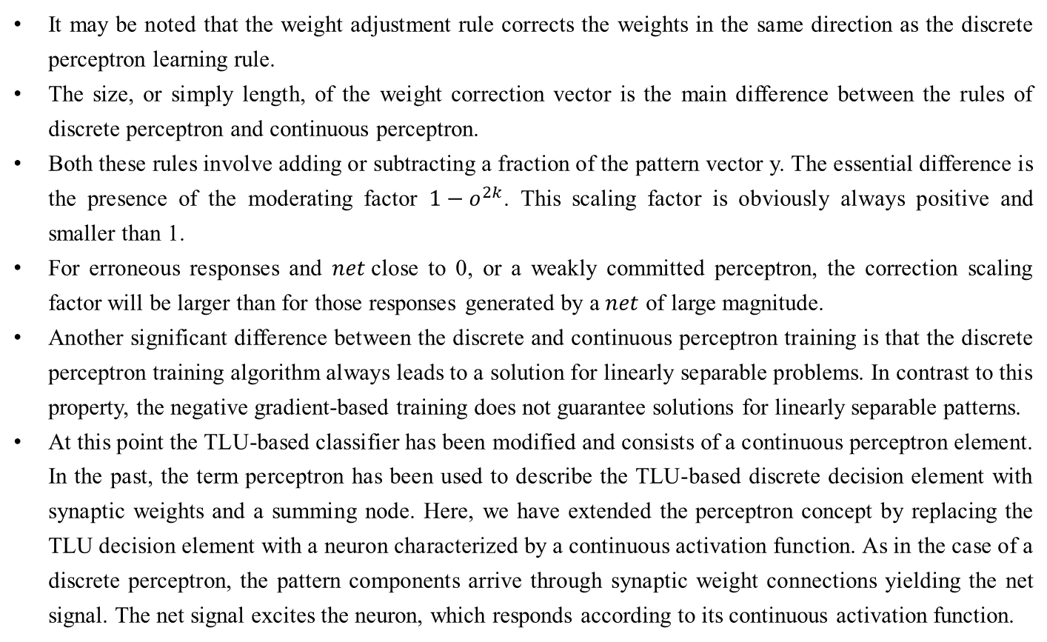
Single Layer continuous perceptron network for linearly separable classification
It may be noted that the weight adjustment rule corrects the weights in the same direction as the discrete perceptron learning rule.
The size, or simply length, of the weight correction vector is the main difference between the rules of discrete perceptron and continuous perceptron.
Both these rules involve adding or subtracting a fraction of the pattern vector y. The essential difference is the presence of the moderating factor $1−o^{2k}$. This scaling factor is obviously always positive and smaller than 1.
For erroneous responses and $net$close to 0, or a weakly committed perceptron, the correction scaling factor will be larger than for those responses generated by a $net$ of large magnitude.
Another significant difference between the discrete and continuous perceptron training is that the discrete perceptron training algorithm always leads to a solution for linearly separable problems. In contrast to this property, the negative gradient-based training does not guarantee solutions for linearly separable patterns.
At this point the TLU-based classifier has been modified and consists of a continuous perceptron element. In the past, the term perceptron has been used to describe the TLU-based discrete decision element with synaptic weights and a summing node. Here, we have extended the perceptron concept by replacing the TLU decision element with a neuron characterized by a continuous activation function. As in the case of a discrete perceptron, the pattern components arrive through synaptic weight connections yielding the net signal. The net signal excites the neuron, which responds according to its continuous activation function.

Slide 51
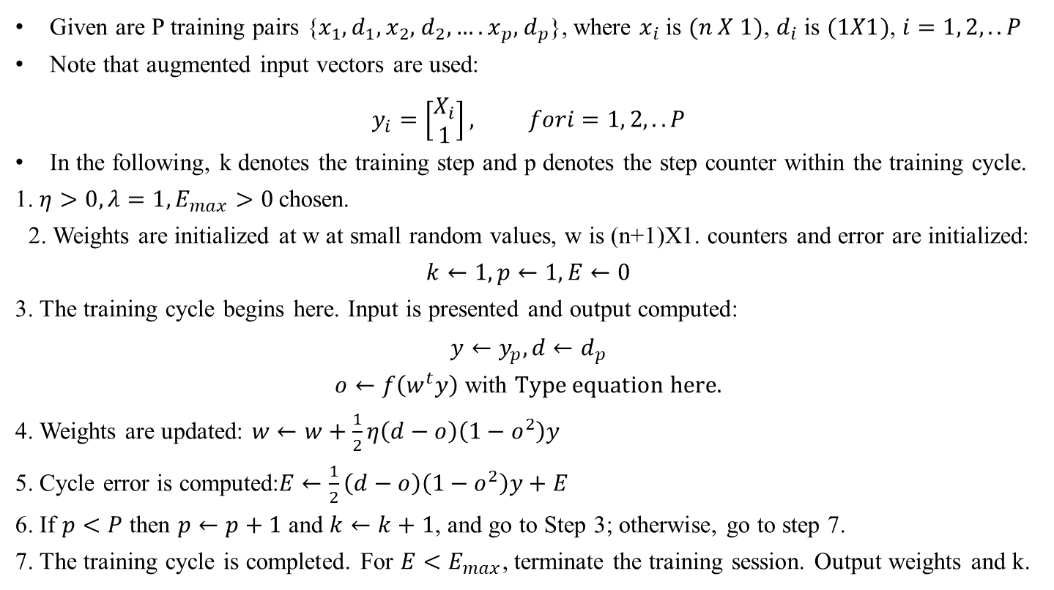
Single continuous perceptron Training Algorithm
Given are P training pairs {$x_{1},d_{1},$ $x_{2},$ $d_{2},….$ $x_{p},$ $d_{p}$}, where $x_{i}$ is $(n X 1)$, $d_{i}$ is $(1X1)$, $i=1, 2,..P$
Note that augmented input vectors are used:
$$y_{i}=\left[\begin{matrix}X_{i} \\ 1\end{matrix}\right], fori=1, 2,..P$$
In the following, k denotes the training step and p denotes the step counter within the training cycle.
1. $η>0, λ=1, E_{max}>0$chosen.
2. Weights are initialized at w at small random values, w is (n+1)X1. counters and error are initialized: $k←1,p←1,E←0$
3. The training cycle begins here. Input is presented and output computed:
$y←y_{p}, d←d_{p}$
$o←f\left(w^{t}y\right)$with
4. Weights are updated: $w←w+\frac{1}{2}η\left(d−o\right)\left(1−o^{2}\right)y$
5. Cycle error is computed:$E←\frac{1}{2}\left(d−o\right)\left(1−o^{2}\right)y+E$
6. If $p<P$ then $p←p+1$ and $k←k+1$, and go to Step 3; otherwise, go to step 7.
7. The training cycle is completed. For $E<E_{max}$, terminate the training session. Output weights and k.

Slide 52

Multi category single layer perceptron networks
Our approach so far has been limited to training of dichotomizers using both discrete and continuous perceptron elements.
In this section we will attempt to apply the error-correcting algorithm to the task of multicategory classification.
The assumption needed is that classes are linearly pairwise separable, or that each class is linearly separable from each other class.
This assumption is equivalent to the fact that there exist R linear discriminant functions such that
$$g_{i}\left(x\right)>g_{j}\left(x\right) for i,j=1,2,….R, i≠j$$
Let us devise a suitable training procedure for such an R-category classifier. To begin, we need to define the augmented weight vector $w_{q}$ as
$$w_{q}≜{\left[w_{q1}{, w}_{q2}….w_{q,n+1}\right]}^{t}$$
Assume that an augmented pattern $y$ of class $i$is presented to the maximum selector-based classifier.
The R decision functions $w_{1}^{t}y$, $w_{2}^{t}y$, ….. $w_{k}^{t}y$ are evaluated. If $w_{i}^{t}y$ is larger than any of the remaining R - 1 discriminant functions, no adjustment of weight vectors is needed, since the classification is correct.
This indicates that
$$w_{1}^{′}=w_{1}, w_{2}^{′}=w_{2}……w_{R}^{′}=w_{R}$$

Slide 53

Multi category single layer perceptron networks
The prime is again used to denote the weights after correction. If, however, for some $m$ value we have $w_{i}^{t}y≤w_{m}^{t}y$, then the updated weight vectors become
$$w_{i}^{′}=w_{i}+cy$$
$$w_{m}^{′}=w_{m}−cy$$
$$w_{k}^{′}=w_{k} for k=1,2…R k≠i,m$$
The matrix formula can be rewritten using the double-subscript notation for the weights as follows:
$$w_{ij}^{′}=w_{ij}+cy_{j} for j=1,2,…n+1$$
$$w_{mj}^{′}=w_{mj}−cy_{j} for j=1,2,…n+1$$
$$w_{kj}^{′}=w_{kj} for k=1,2,…R, k≠i,m,j=1,2,…n+1$$
It can be seen from Eq. that the weight value of the connection between the $i′th$ output and the $j′th$ component of the input is supplemented with ${cy}_{j}$ if the $i′th$ output is too small.
The weight value toward the $m′th$ output from the $j′th$ component of the input is reduced by ${cy}_{j}$ if the $m′th$ output is excessive.
So far in this chapter we have been dealing with the augmented pattern vector y with the $(n + 1)′th$component always of fixed value + 1.
It is somewhat instructive to take a different look at this fixed component of the pattern vector to gain better insight into the perceptron's thresholding operation.

Slide 54


Multi category single layer perceptron networks
Figure shows the perceptron-based dichotomizer in which the augmented pattern component is $y_{n+1}=−1$.
Let us assume now that the neuron is excited as in Figure (a). We can now write that
$$net=w^{t}x−w_{n+1}$$
Denoting${ w}_{n+1}$ as the neuron activation threshold, or bias, value equals T
$$T≜w_{n+1}$$
it becomes obvious that the output of the neuron can be expressed as
$$f\left(net\right)=\left\{\begin{matrix}>0 for w^{t}x>T \\ <0 for w^{t}x<T\end{matrix}\right.$$

Slide 55

Multi category single layer perceptron networks
The activation function expressed now in the form of f($w^{t}x$) with $w^{t}x$ as an argument is shown in Figure (b).
The figure shows an activation function of a neuron with the positive threshold value, T > 0, and sketched versus nonaugmented activation $w^{t}x$ .
It is instructive to notice that now the $(n + 1)′th$weight value is equal to the threshold T, and the neuron is excited if the weighted sum of the original unaugmented pattern exceeds the threshold value T.
Otherwise, the neuron remains inhibited. The nonzero threshold value causes the neuron to behave as a biased device with T being its bias level.
It is important to stress again that from the training viewpoint, any value $y_{n+1}=const$ is an appropriate choice.
When $y_{n+1}=−1$, however, the $w_{n+1}$ value becomes equal to the actual firing threshold of the neuron with input being the original pattern x.
In further considerations we will use $y_{n+1}=−1$and $w_{n+1}$= T unless otherwise stated.

Slide 56


Multi category single layer perceptron networks
Let us now try to eliminate the maximum selector in an R-class linear classifier and replace it first with R discrete perceptron's.
The network generated this way is comprised of R discrete perceptron's as shown in Figure.
The properly trained classifier from Figure should respond with $i_{o} = 1$ when $g_{1}(x)$ is larger than any of the remaining discriminant functions $g_{i}(x)$ , for $i=1,2,…R$, for all patterns belonging to $χ_{1}$.
Instead of signaling the event by single output maximum selector responding with $i_{o} = 1,$a TLU #1 as I figure may be used. Then outputs $o_{1} = 1$ and $o_{2}=o_{3}=…=o_{R}=−1$ should indicate category 1 input.

Slide 57

Multi category single layer perceptron networks
The adjustment of threshold can be suitably done by altering the value of $w_{1,n+1}$through adding additional threshold value T1.
Such an adjustment is clearly feasible since $g_{1}(x)$ exceeds all remaining discriminant values for all x in $χ_{1}$.
The adjustment is done by changing only the single weight value $w_{1,n+1}$at the input of the first TLU by T1.
None of the remaining weights is affected during T1 setting step with the input of class 1.
Applying a similar procedure to the remaining inputs of the maximum selector, the classifier using R individual TLU elements as shown in Figure can be obtained.
For this classifier, the k’th TLU response of +1 is indicative of class k and all other TLUs respond with -1.

Slide 58

Multi category single layer perceptron networks
The training procedure outlined uses the maximum selector network.
For our neural network studies however, architectures with the TLU elements are much more important than those with maximum selectors.
The approach can be used to devise the multicategory perceptron-based classifier by replacing the maximum selector through R threshold logic units.
Alternatively, direct supervised training of the network of Figure can be performed. The weight adjustment during the k'th step for this network is as follows:
$$w_{i}^{k+1}=w_{i}^{k}+\frac{c^{k}}{2}\left(d_{i}^{k}−o_{i}^{k}\right)y^{k}, for i=1,2,…R$$
Where $d_{i}$ and $o_{i}$ are the desired and actual responses, respectively, of the i'th discrete perceptron. The formula expresses the R-category discrete perceptron classifier training.
For R-category classifiers with so-called local representation, the desired response for the training pattern of the i'th category is
$$d_{i}=1, d_{j}=−1 for j=1,2,…R; j≠i$$
For R-category classifiers with so-called distributed representation, condition is not required, because as more than a single neuron is allowed to respond + 1 in this mode.

Slide 59

R-category discrete perceptron Training Algorithm
Given are P training pairs {$x_{1},d_{1},$ $x_{2},$ $d_{2},….$ $x_{p},$ $d_{p}$}, where $x_{i}$ is $(n X 1)$, $d_{i}$ is $(RX1)$, $i=1, 2,..P$
Note that augmented input vectors are used:
$$y_{i}=\left[\begin{matrix}X_{i} \\ −1\end{matrix}\right], for i=1, 2,..P$$
In the following, k denotes the training step and p denotes the step counter within the training cycle.
$c>0$ is chosen.
Weights are initialized at W at small random values, $W=\left[w_{ij}\right]$ is $RX(n+1)$. counters and error are initialized: $k←1,p←1,E←0$
3. The training cycle begins here. Input is presented and output computed:
$y←y_{p}, d←d_{p}$
$o←sgn\left(w^{t}y\right) for i=1, 2,….R$ w$here w_{i}$ is the $i’th$ row of W.
4. Weights are updated: $w_{i}←w_{i}+\frac{1}{2}c\left(d_{i}−o_{i}\right)y, for i=1,2,…..R$
5. Cycle error is computed:$E←\frac{1}{2}{\left(d_{i}−o_{i}\right)}^{2}+E$ $for i=1,2,…..R$
6. If $p<P$ then $p←p+1$ and $k←k+1$, and go to Step 3; otherwise, go to step 7.
7. The training cycle is completed. For E=0, terminate the training session. Output weights and k.

Slide 60


Examples
Example: Using Madaline network, implement XOR function with bipolar inputs and targets. Assume the required parameters for training of the network.
Solution:
The training pattern for XOR function with bipolar inputs and targets is shown in table.
The Madaline algorithm in which the weights between the hidden layer and output layer remain fixed is used for training the network.
Initializing the weights to small random values, the network architecture is shown in figure with initial weights.
x1 | x2 | t
1 | 1 | -1
1 | -1 | 1
-1 | 1 | 1
-1 | -1 | -1
The initial weights and bias are
$$\left[\begin{matrix}w_{11} & w_{21} & b_{1}\end{matrix}\right]=\left[\begin{matrix}0.05 & 0.2 & 0.3\end{matrix}\right],$$
$$\left[\begin{matrix}w_{12} & w_{22} & b_{2}\end{matrix}\right]=\left[\begin{matrix}0.1 & 0.2 & 0.15\end{matrix}\right]$$
$$\left[\begin{matrix}v_{1} & v_{2} & b_{3}\end{matrix}\right]=\left[\begin{matrix}0.5 & 0.5 & 0.5\end{matrix}\right]$$

Slide 61




Examples
For first input sample, $x_{1}=1, x_{2}=1, target t=−1, and learning rate α equal to 0.5:$
Calculate net input to the hidden units:
$$z_{in1}=b_{1}+x_{1}w_{11}+x_{2}w_{21}$$
$$=0.3+1∗0.05+1∗0.2=0.55$$
$$z_{in2}=b_{2}+x_{1}w_{12}+x_{2}w_{22}$$
$$=0.15+1∗0.1+1∗0.2=0.45$$
Calculate the output $z_{1}, z_{2}$ by applying the activation over the net input computed. The activation function is given by
Hence,
After computing the output of the hidden units, then find the net input entering into the output unit:

Slide 62




Examples
Apply the activation function over the net input $y_{in}$to calculate the output y:
Since $t≠y$, weight Updation has to be performed. Also since $t=−1$, the weights are updated on $z_{1}$ and $z_{2}$ that have positive net input. Since here both net inputs $z_{in1}$ and $z_{in2}$ are positive, updating the weights and bias on both hidden units, we obtain

